Slide 1
The European Chemical industry Facts and Figures 2023
To replace the background image:
1/Go to Slide Master (Menu “View”)
2/Right-click on the image
3/Select “Replace image…”
4/Close the Slide Master
A vital part of Europe’s Future
05 December 2023

Slide 2
1. Profile - key figures

Slide 3
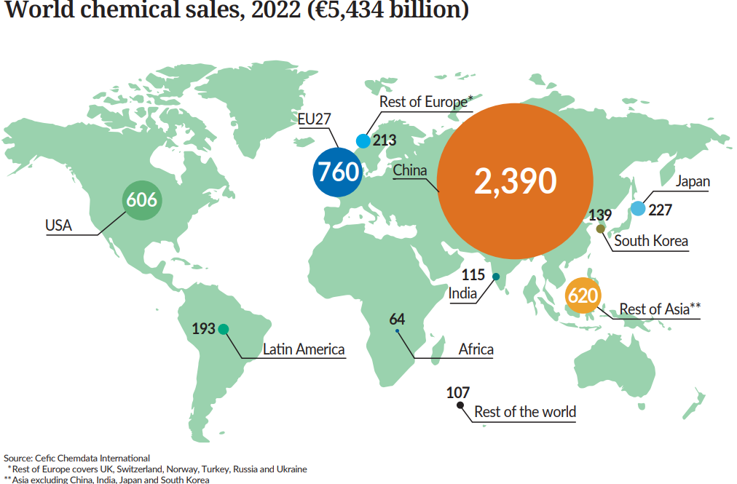
Europe is the second-largest chemical producer in the world

Slide 4
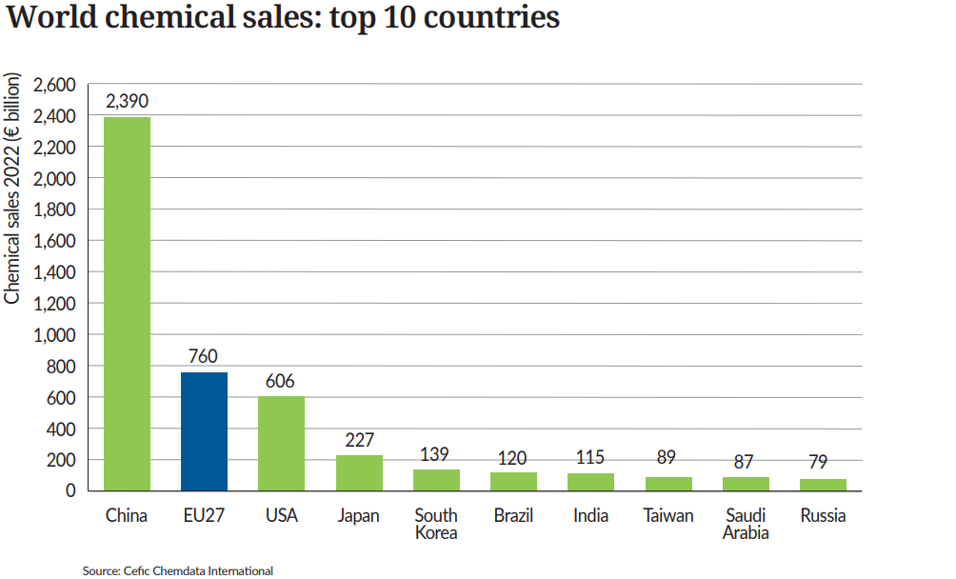
China dominates chemical sales globally

Slide 5
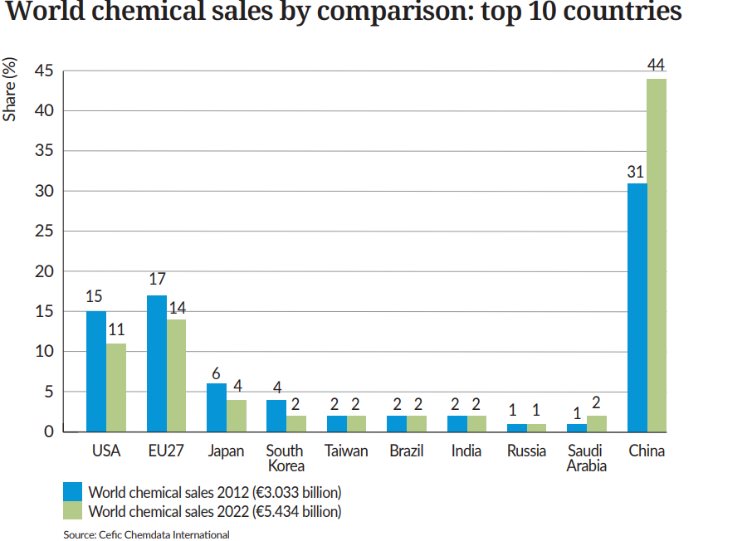
EU27 market share dropped significantly

Slide 6
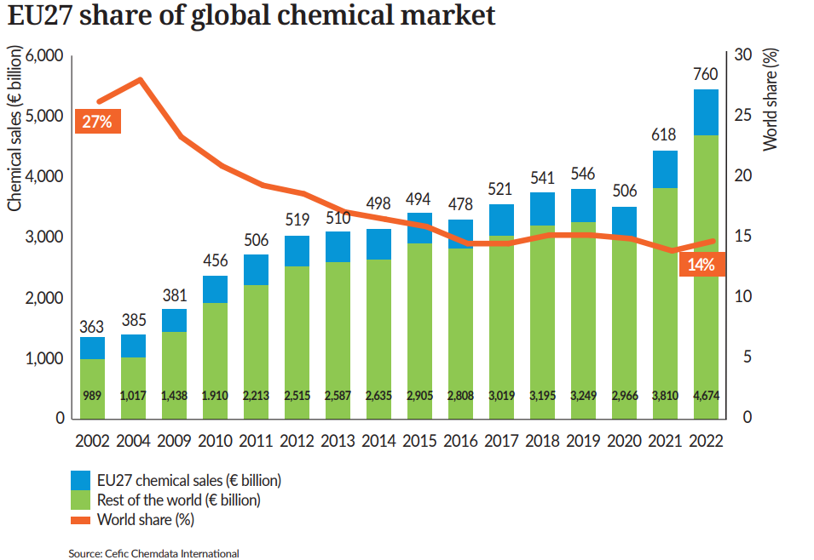
Over 20 years, the world market share of EU27 chemical sales drops sharply

Slide 7
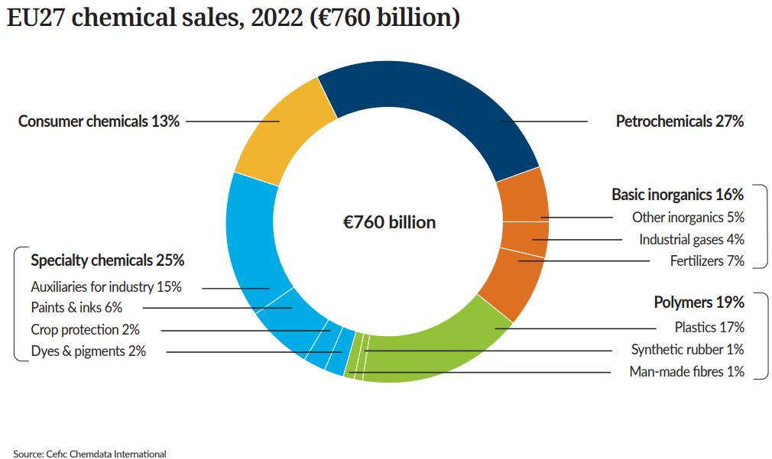
Petrochemicals account for more than one fourth of EU27 chemical sales

Slide 8
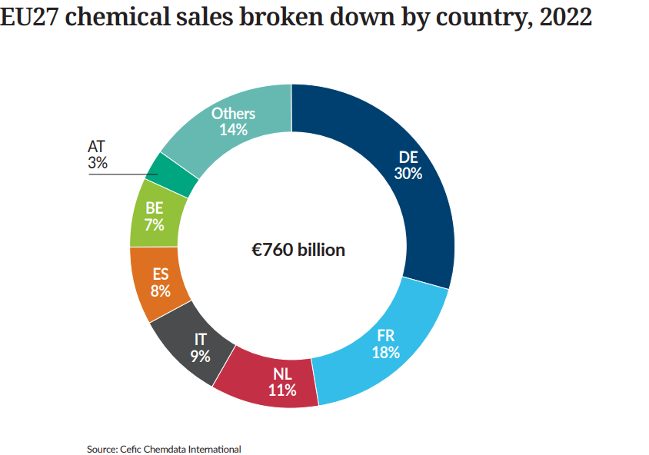
Two thirds of EU27 chemical sales generated in four Member States

Slide 9
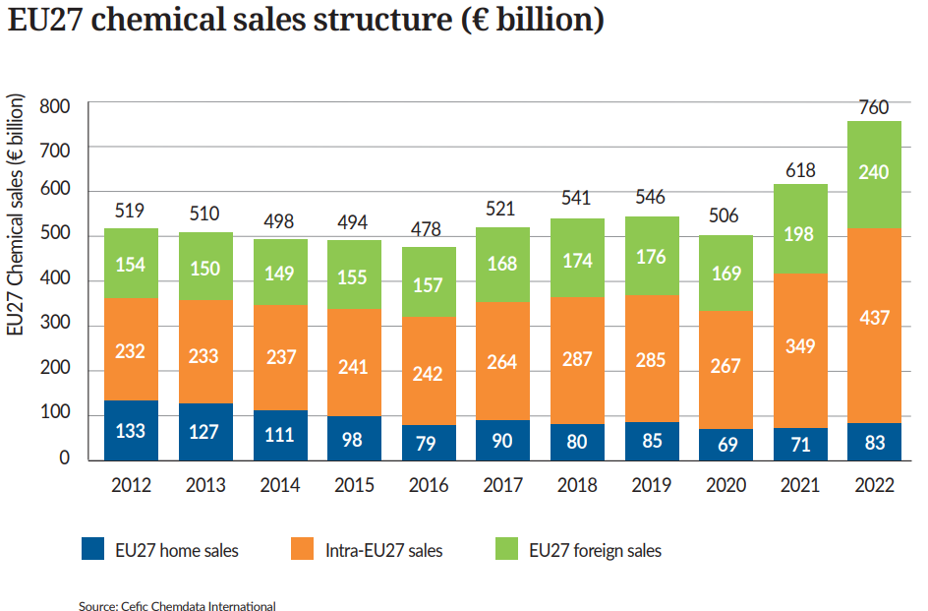
EU27 chemical sales significantly increased in 2022

Slide 10
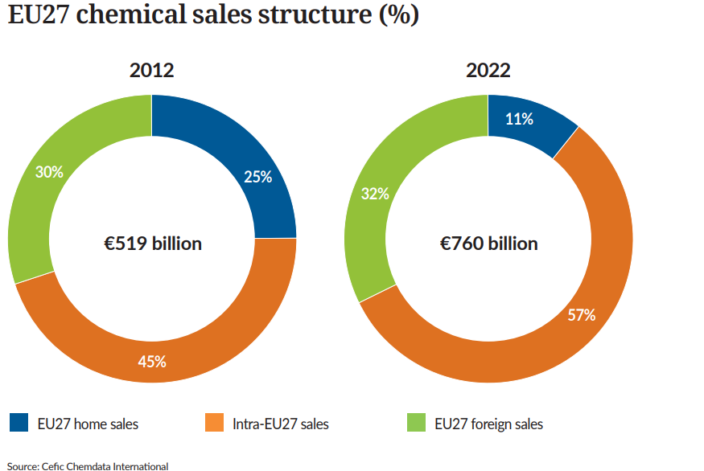
Nearly one third of EU27 chemical sales is generated from exports

Slide 11
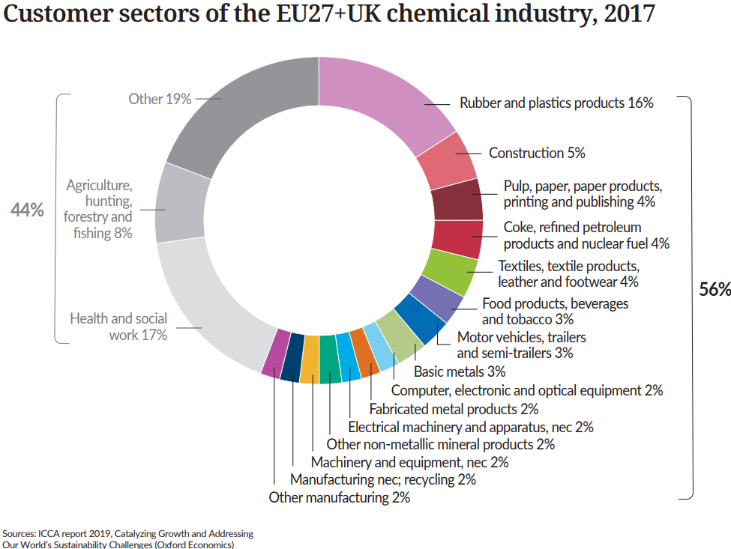
More than half of EU chemicals are supplied to the industry

Slide 12
2. Trade Development

Slide 13
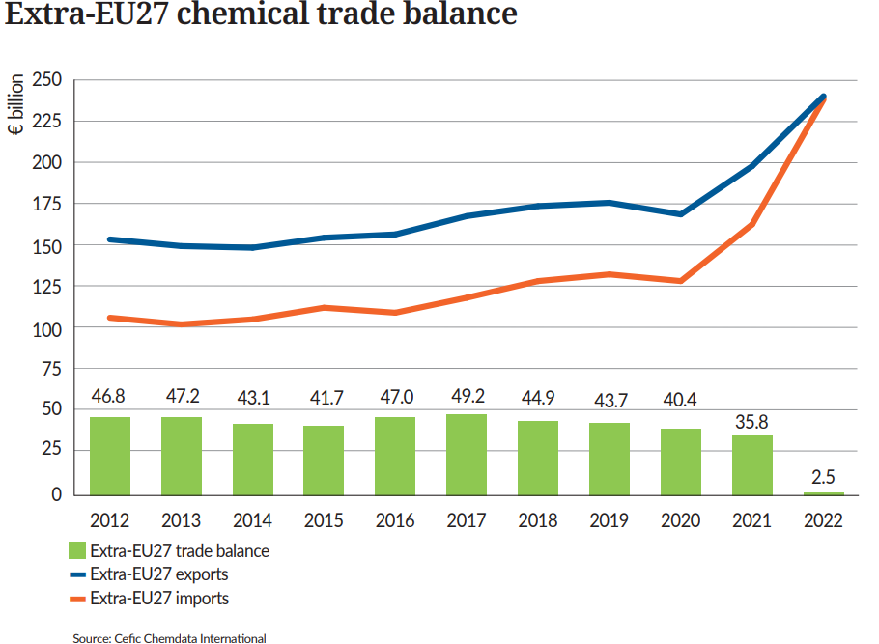
EU27 chemical trade surplus reaches a lower level in 2022

Slide 14
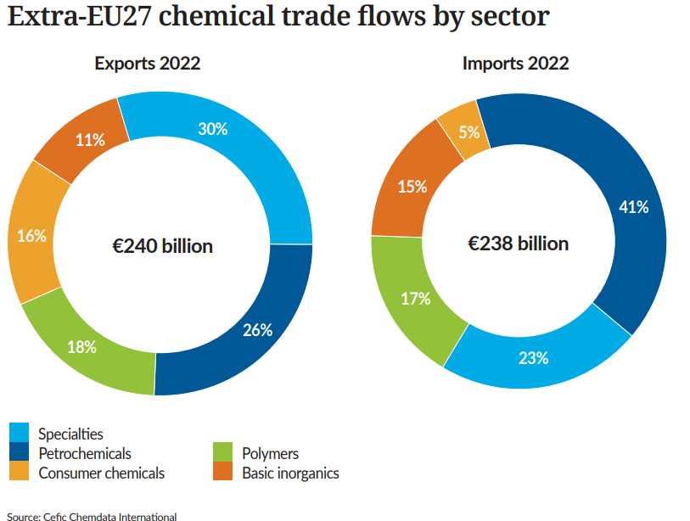
Petrochemicals contributes most to EU27 chemical trade

Slide 15
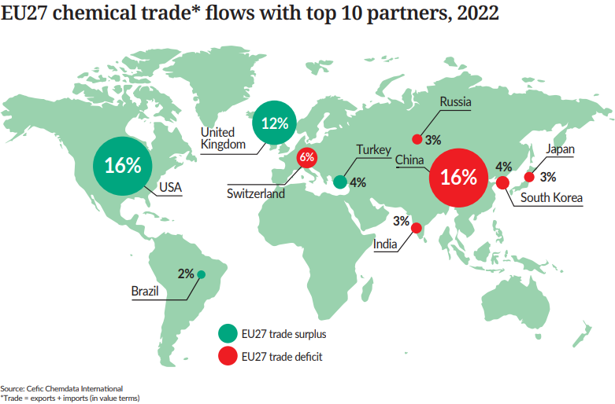
Top 10 EU27 partners account for two thirds of EU27 chemical trade*

Slide 16
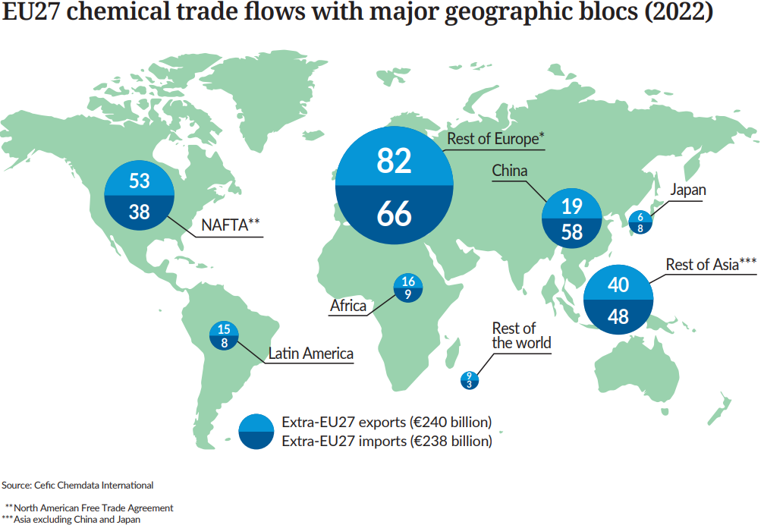
EU27 holds trade surplus with top competing regions

Slide 17
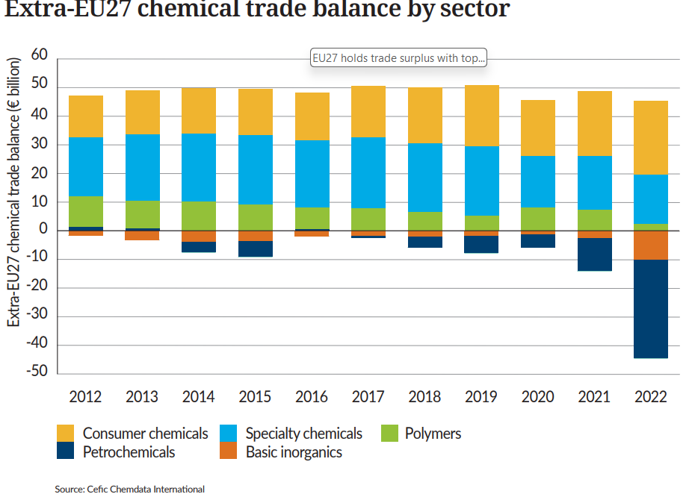
Consumer chemicals contribute most to EU27 chemical trade surplus

Slide 18
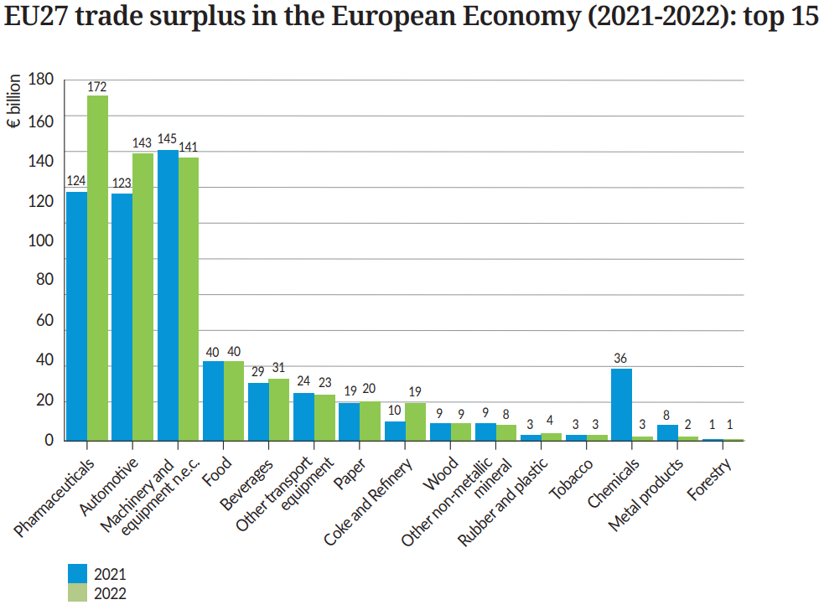
Chemicals* generates one of the lowest surplus in the European Economy

Slide 19
3. Growth and Competitiveness

Slide 20
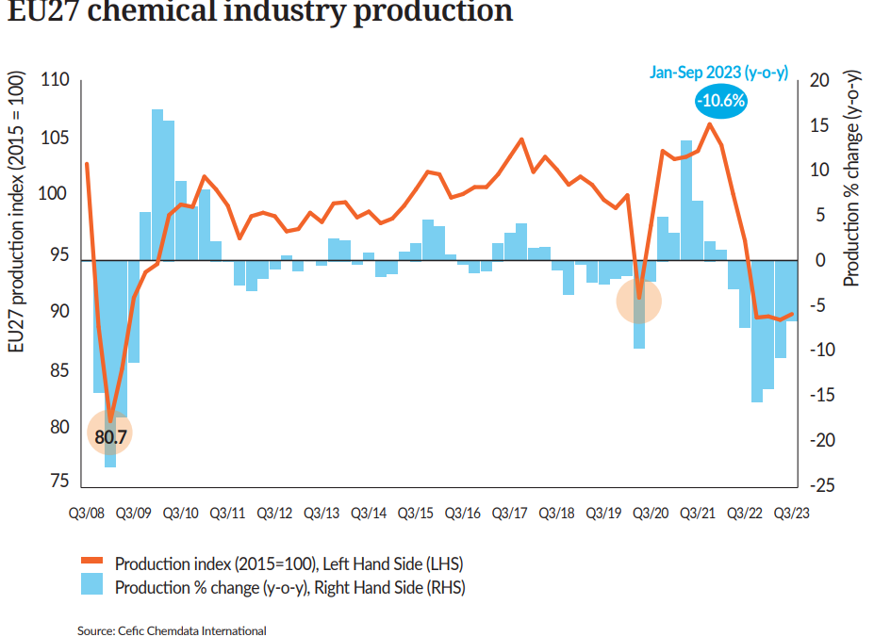
EU27 chemicals output, far below the previous year’s level

Slide 21
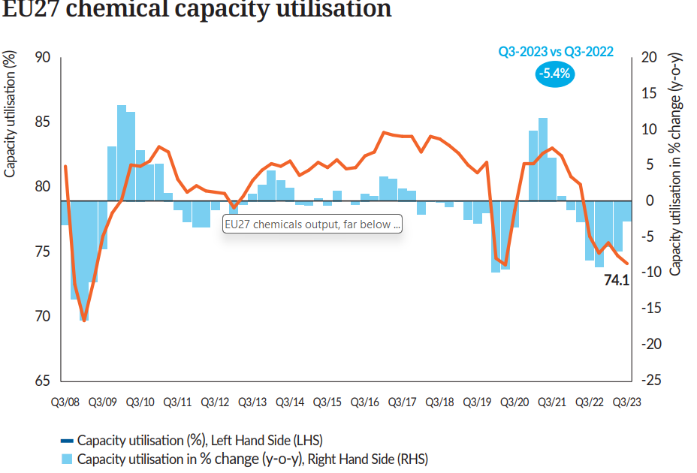
EU27 capacity utilisation below its long-term average

Slide 22
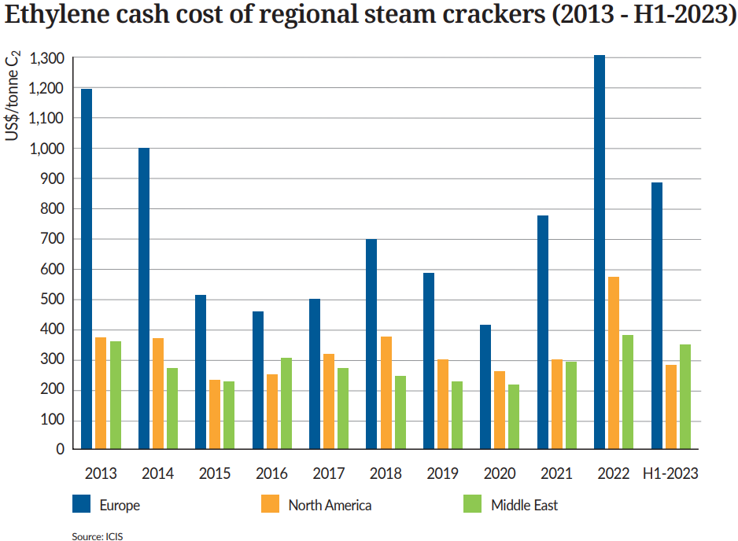
Europe at a competitive disadvantage compared to North America
and Middle East

Slide 23
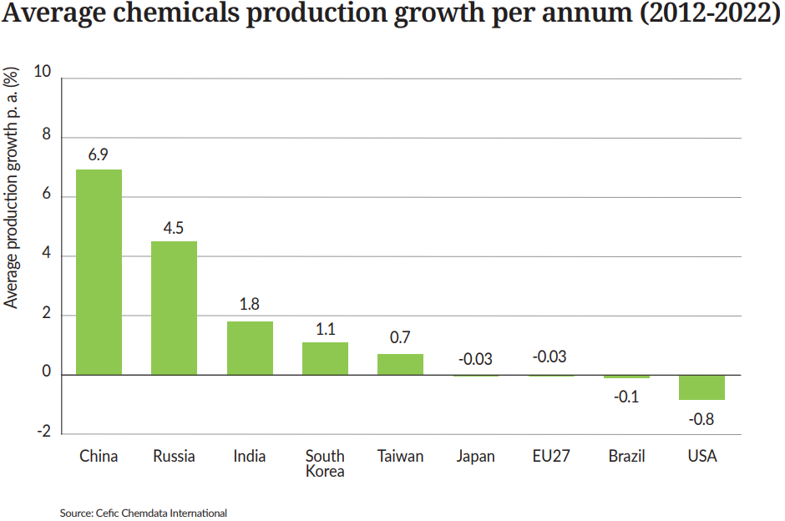
Key emerging economies grow faster than the EU27 and the USA

Slide 24
4. Our contribution to EU industry

Slide 25
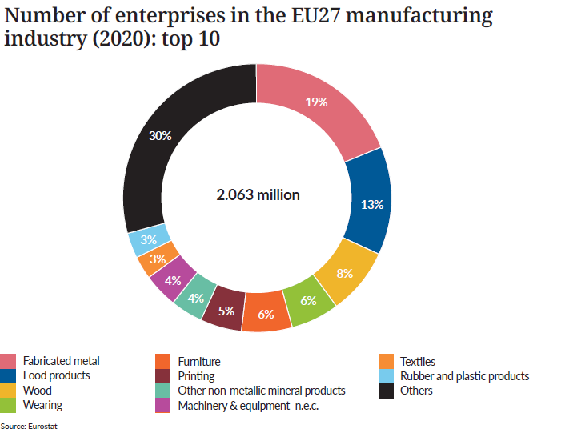
Top 10 sectors account for 70% of total EU27 manufacturing enterprises

Slide 26
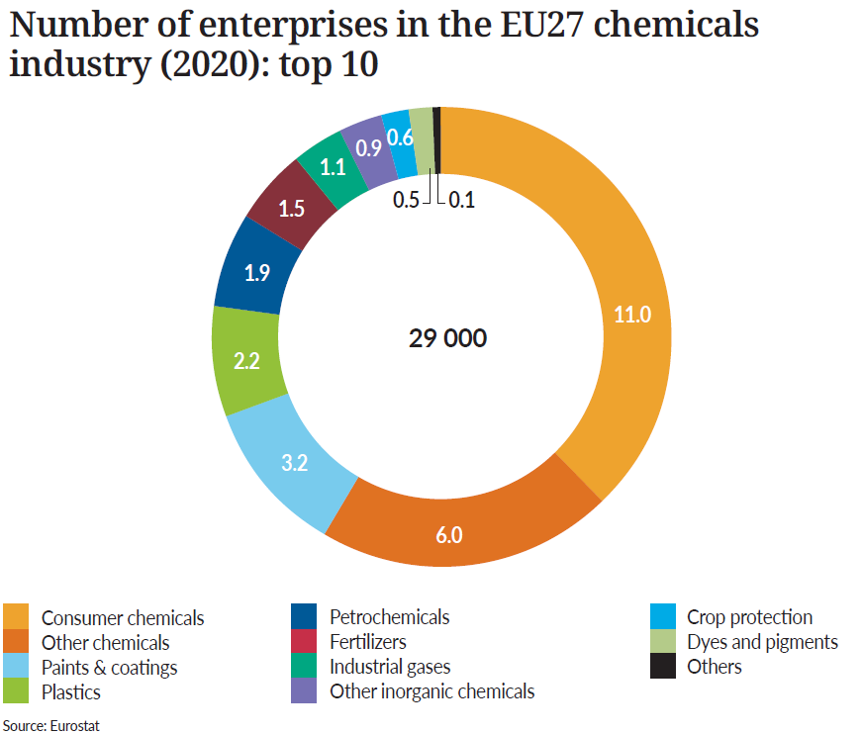
Consumer chemicals has the highest number of chemicals enterprises

Slide 27
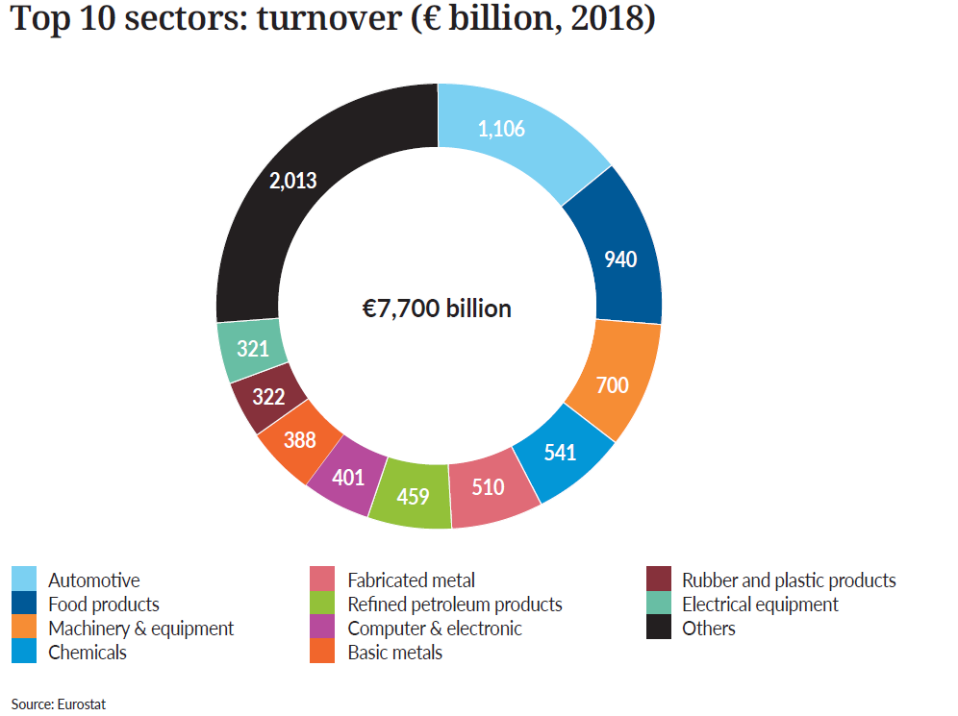
Chemicals is the fourth-largest producer in EU27 manufacturing sector

Slide 28
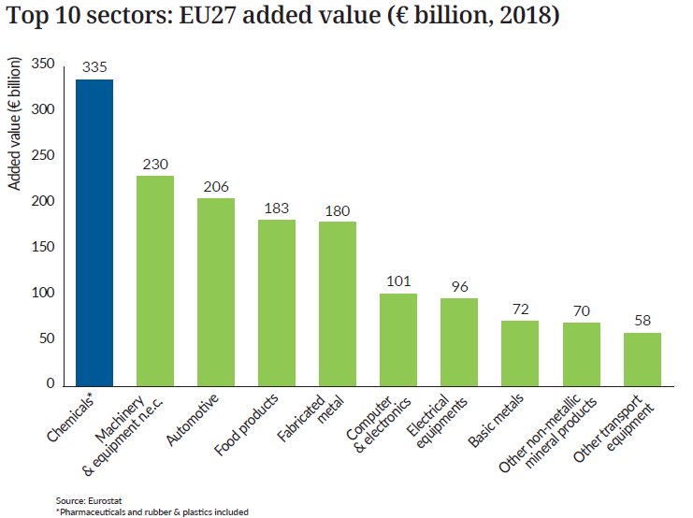
Chemicals* is the leading sector in terms of added value

Slide 29
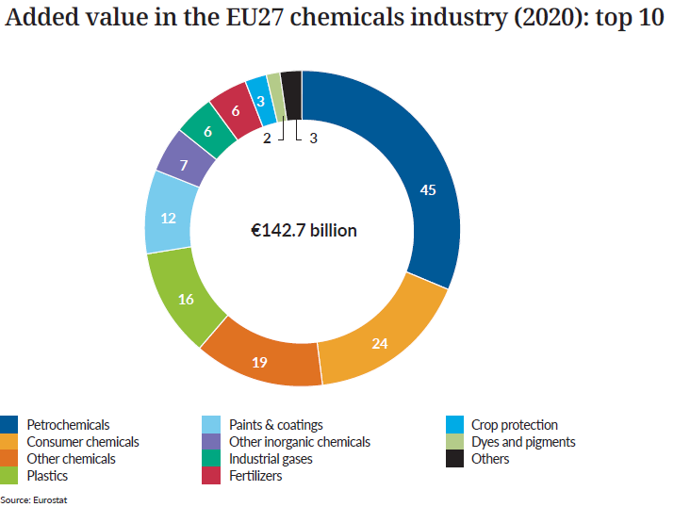
Petrochemicals has the highest added value in EU27 chemicals sector

Slide 30
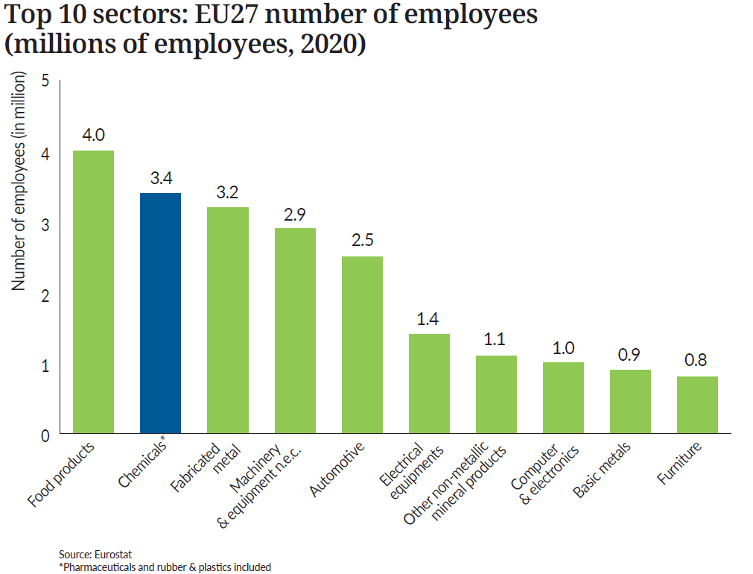
Chemicals* contributes 12% of EU27 manufacturing employment

Slide 31
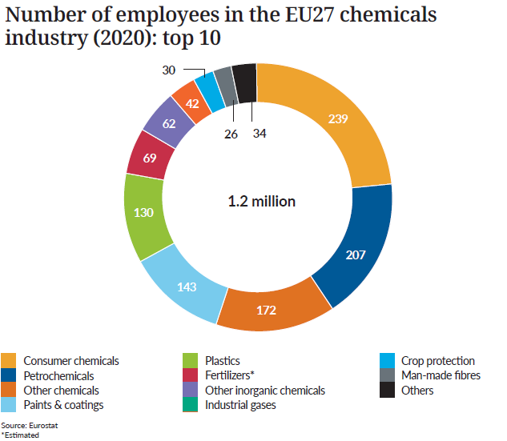
Consumer chemicals is the largest employer in the EU27 chemicals sector

Slide 32
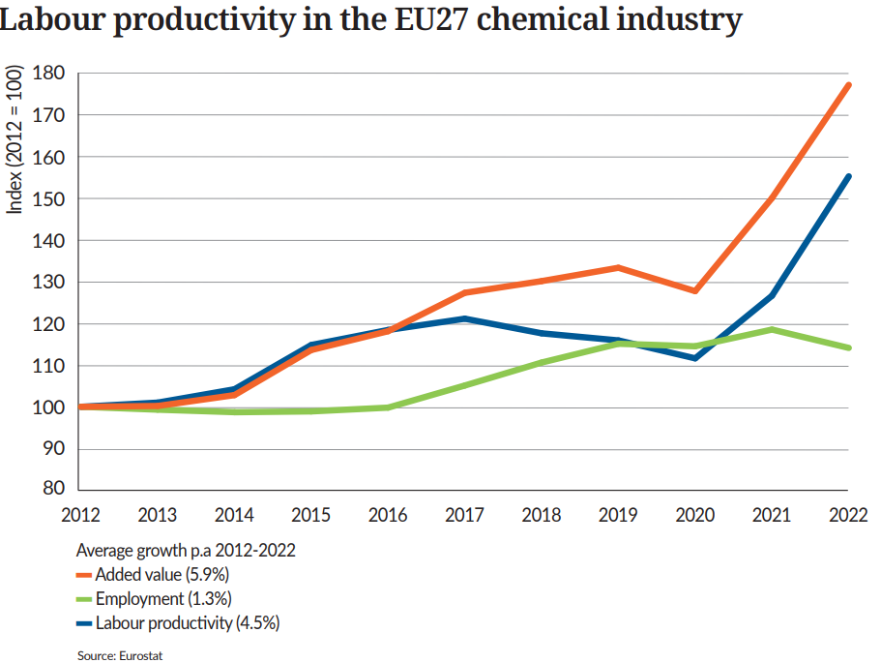
EU27 Labour productivity grows at 4.5%

Slide 33
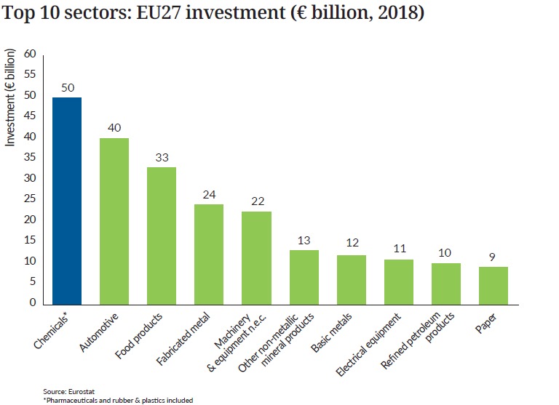
Chemicals* is the largest investor in EU27 manufacturing sector

Slide 34
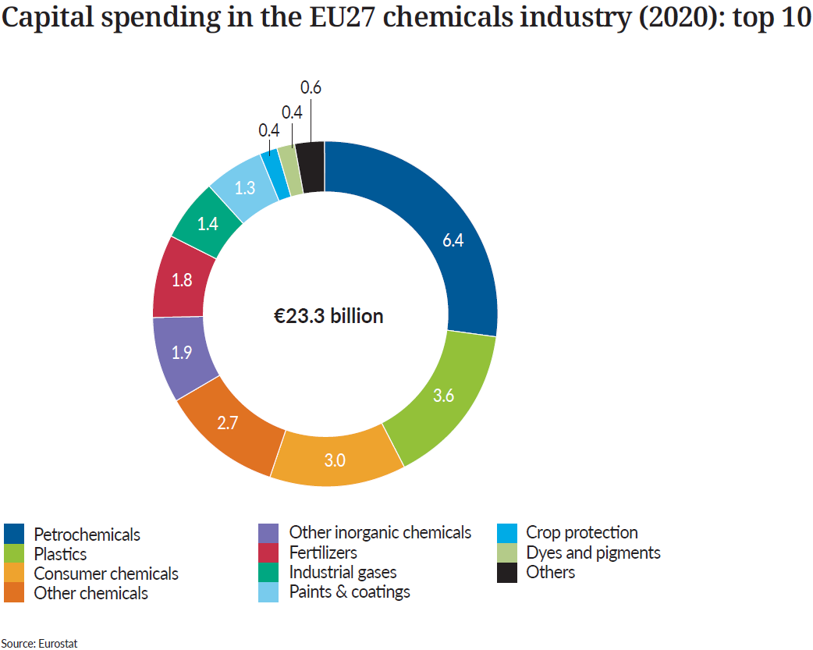
Petrochemicals is the largest investor in the EU27 chemicals sector

Slide 35
5. Energy Consumption

Slide 36
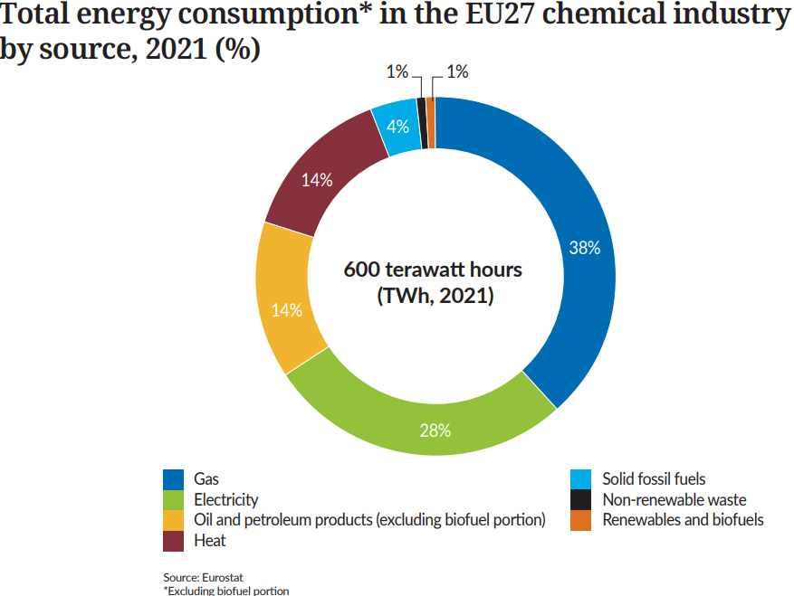
EU27 gas and electricity account for two thirds of total energy consumption

Slide 37
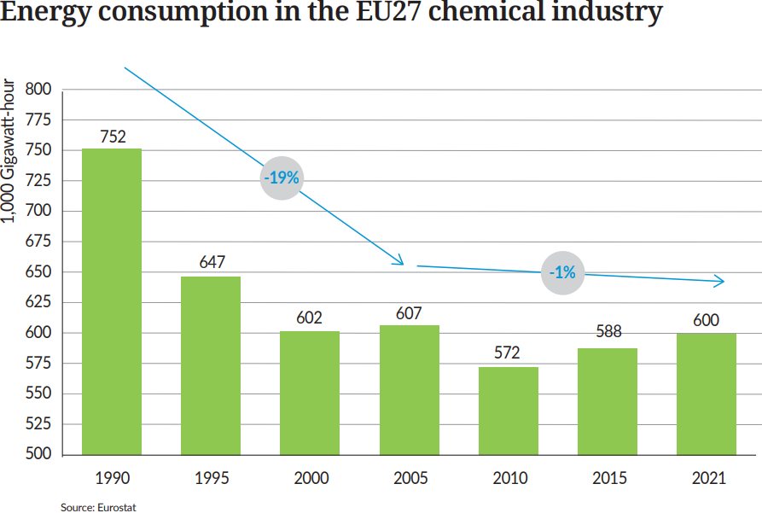
EU27 energy consumption falls 20% since 1990

Slide 38
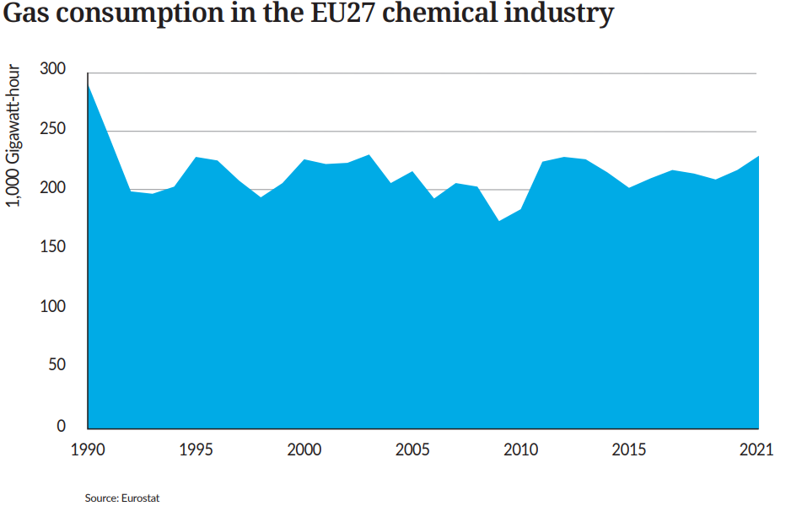
EU27 gas consumption falls 21% since 1990

Slide 39
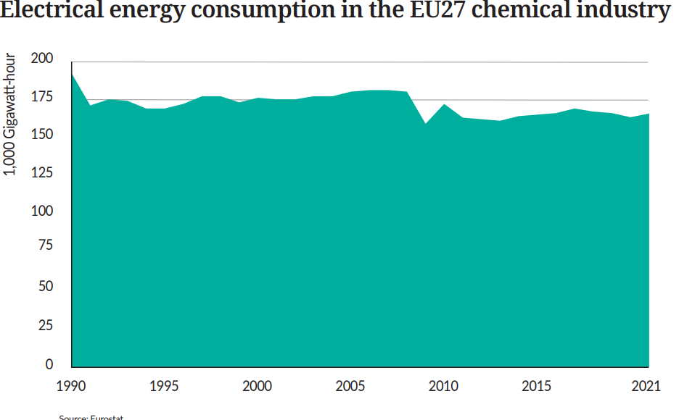
EU27 electrical energy consumption falls 14% since 1990

Slide 40
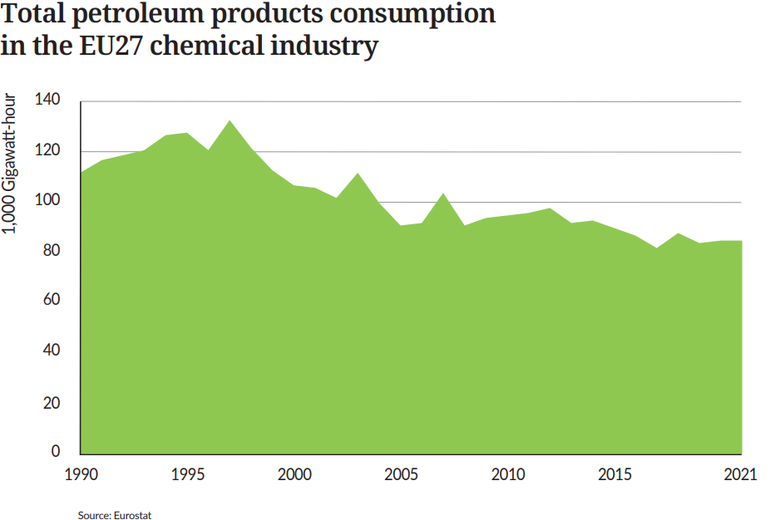
EU27 Total petroleum consumption falls 24% since 1990

Slide 41
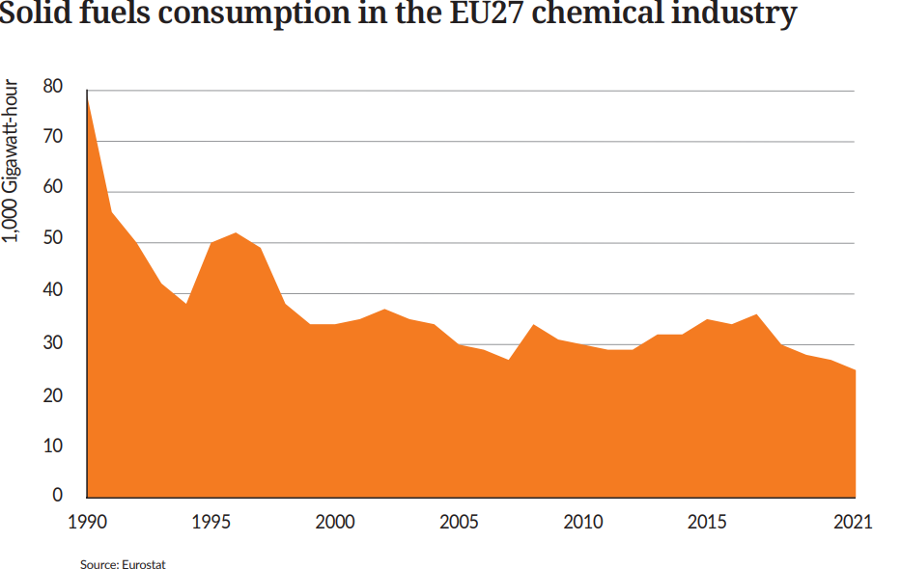
EU27 solid fuels consumption falls 69% since 1990

Slide 42
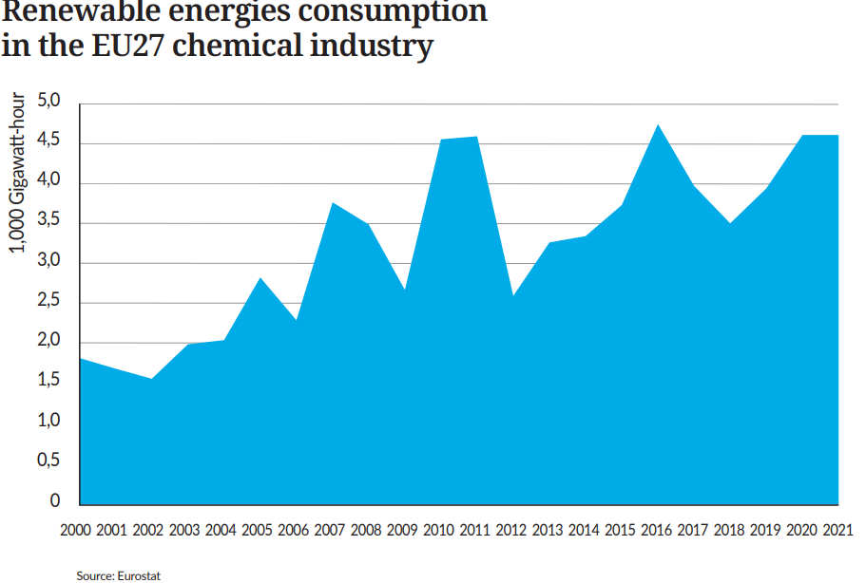
EU27 Renewable energies consumption more than doubled

Slide 43
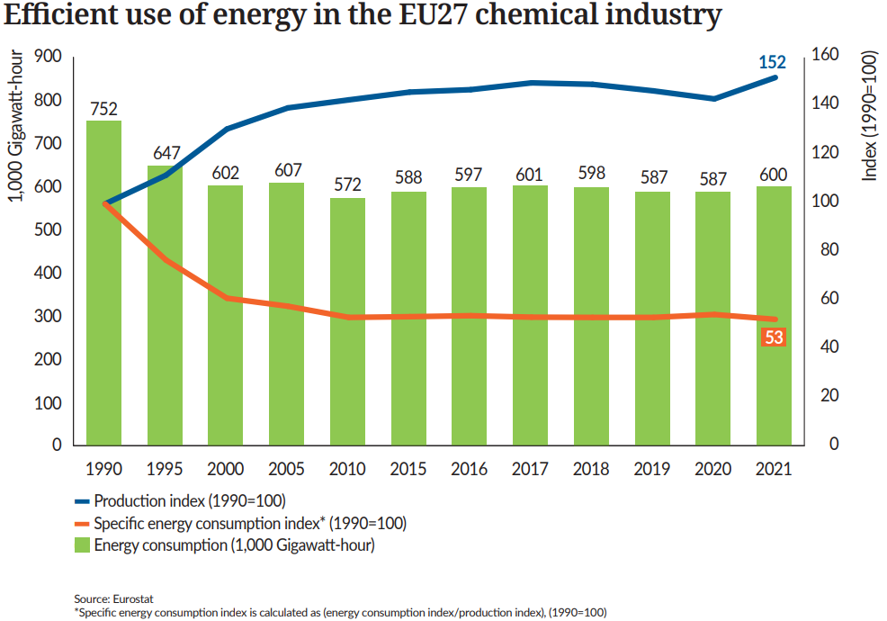
EU27 specific energy consumption* dropped by 48%

Slide 44
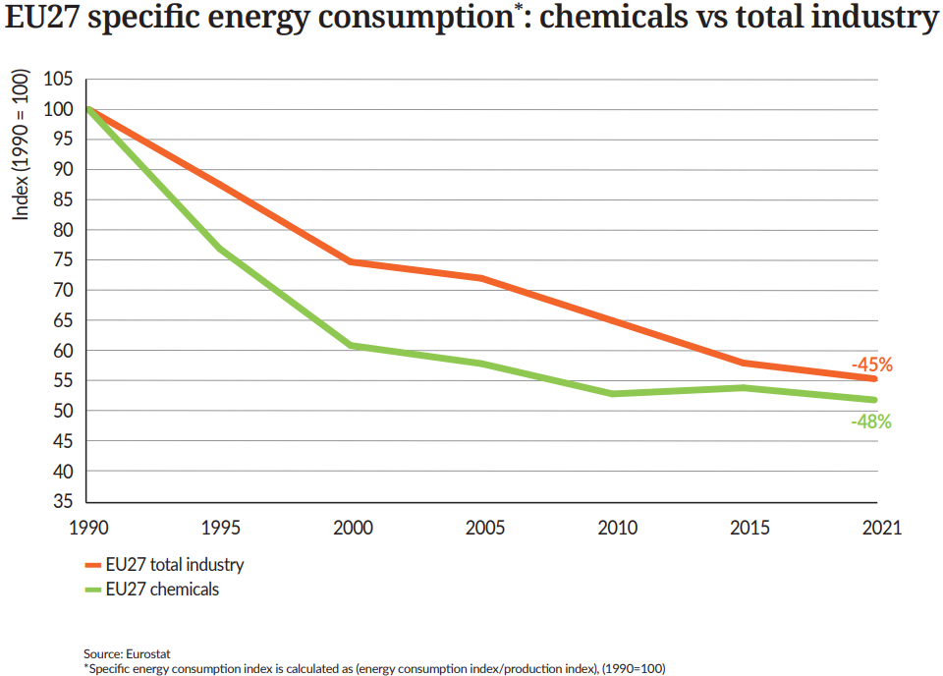
EU27 chemicals performance* is slightly higher than overall industry

Slide 45
6. Capital and R&I Spending

Slide 46
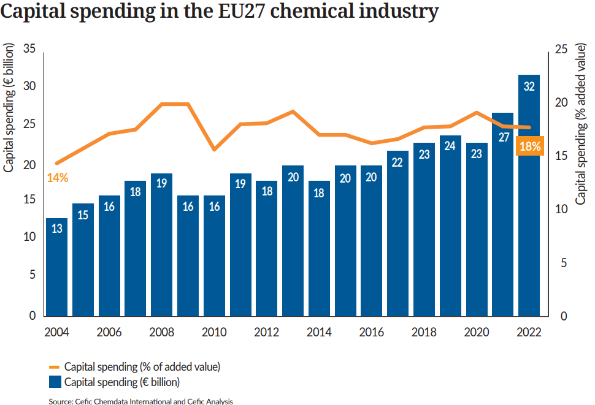
EU27 capital spending increased significantly in 2022

Slide 47
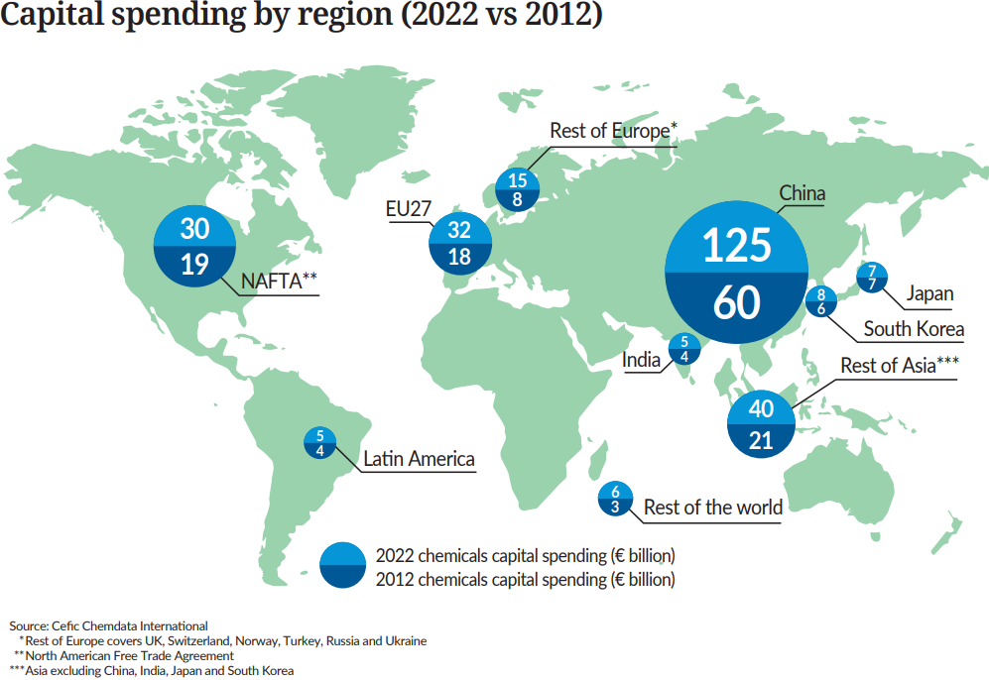
China leads the global chemicals investment

Slide 48
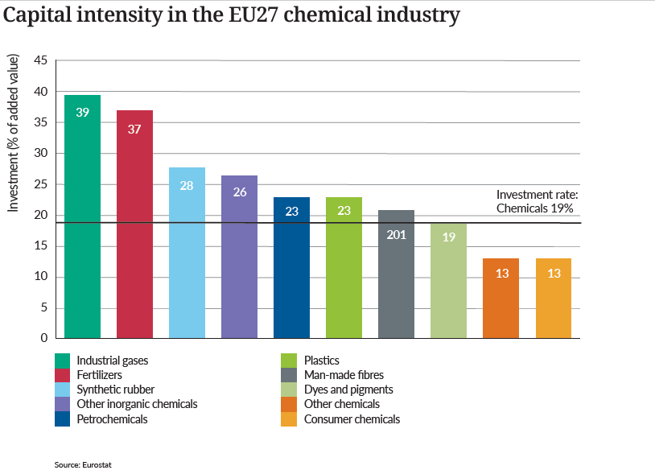
Hight capital intensity in the EU27 chemical sector

Slide 49
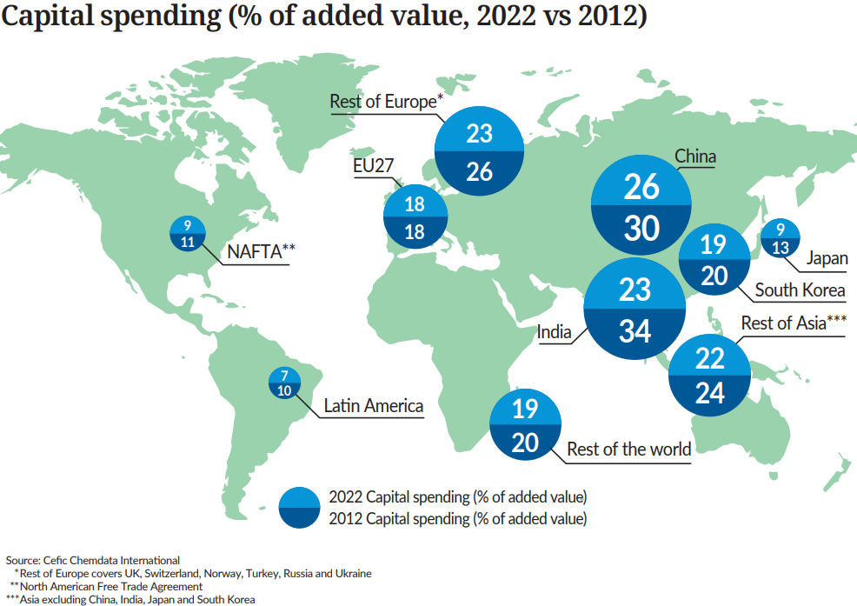
EU27 capital intensity below China and India economies

Slide 50
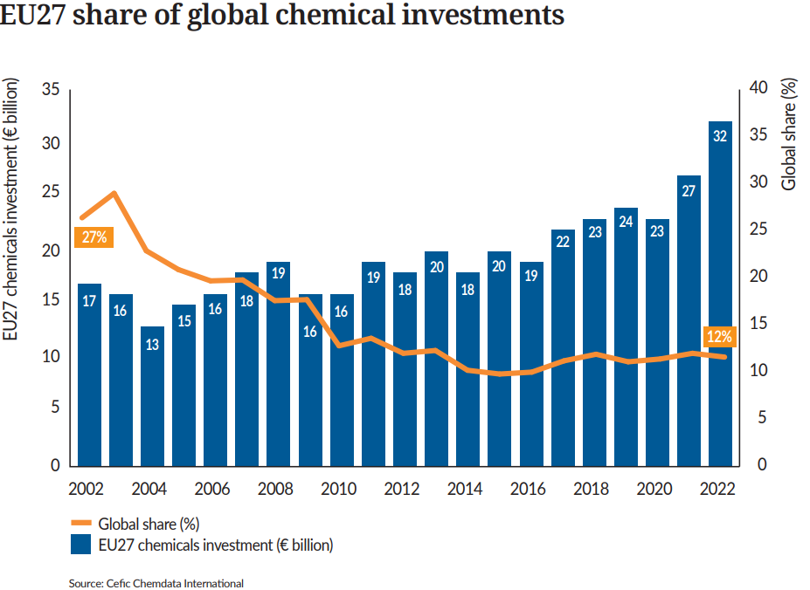
EU27 loses more than 50% of its original market share

Slide 51
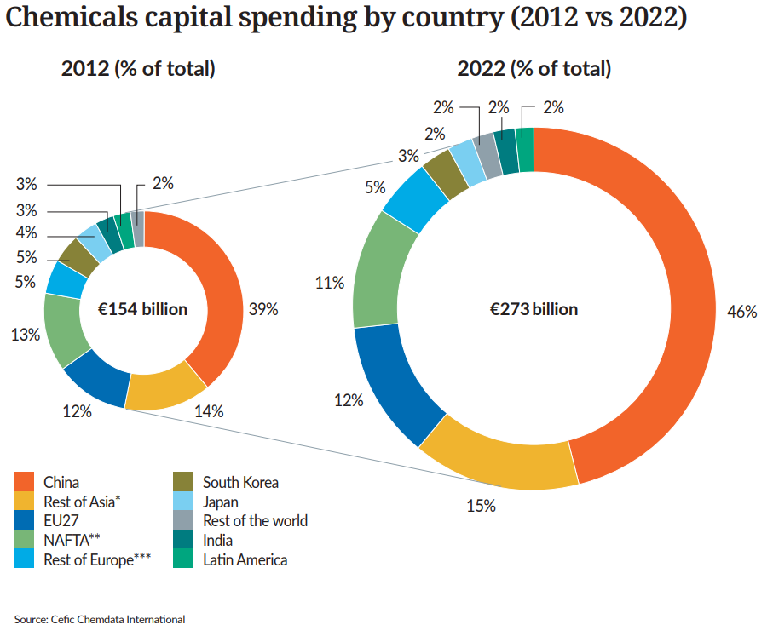
Decreasing share of chemicals capital spending for the EU27

Slide 52
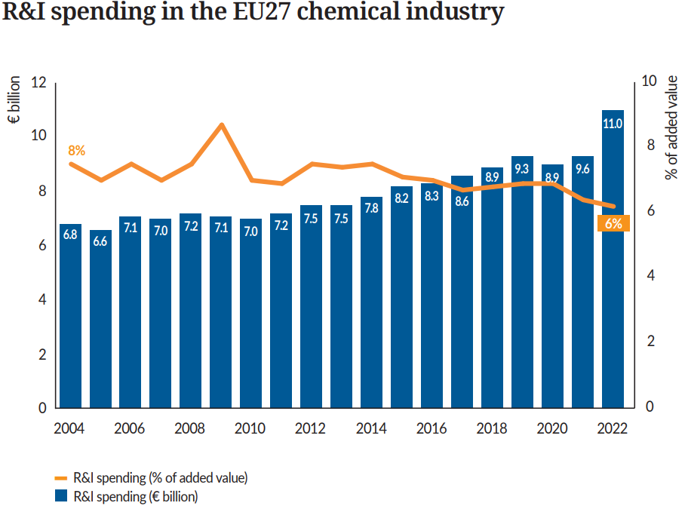
EU27 R&I spending reaches the highest level in 2022

Slide 53
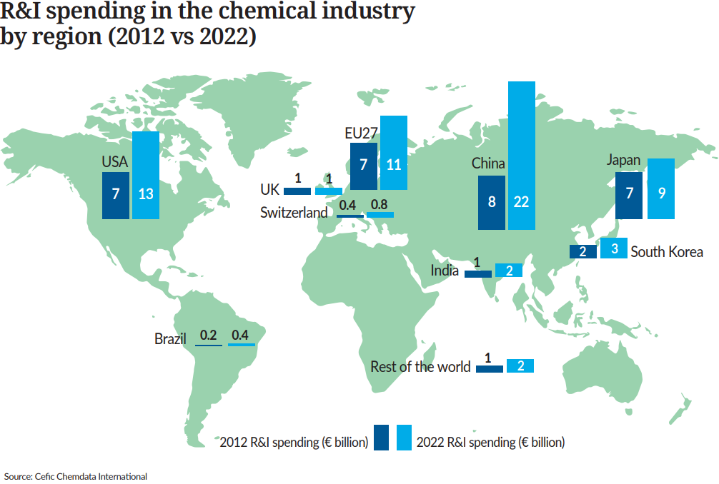
EU27 is the one of the third-largest R&I investor in the world

Slide 54
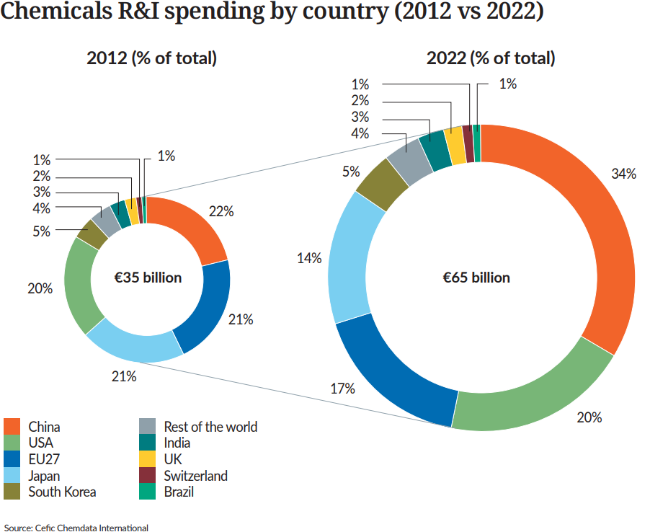
Decreasing share of R&I spending for the EU27 and Japan

Slide 55
7. Environmental Performance

Slide 56
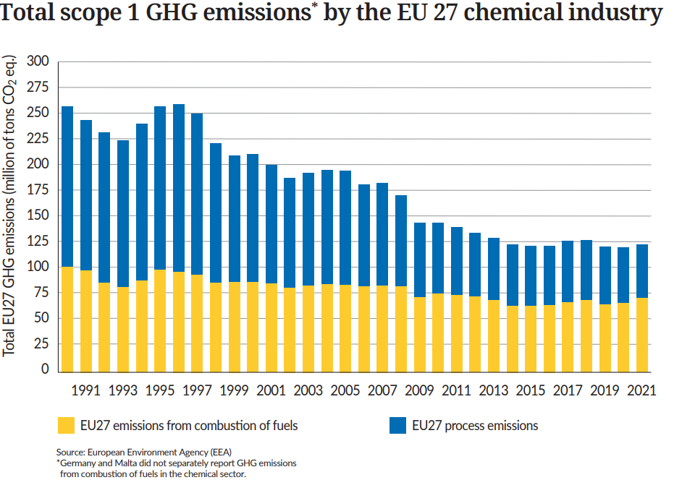
EU27 scope 1 GHG emissions fall 52% since 1990

Slide 57
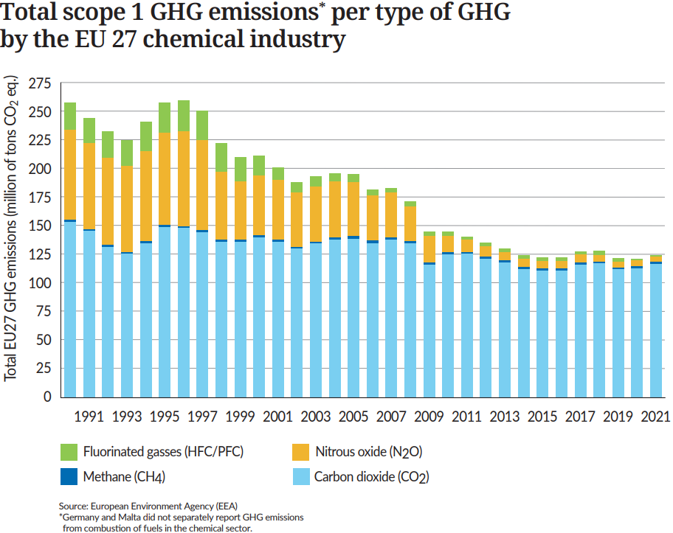
EU27 scope 1 GHG emissions* fall by 133 million tonnes (CO2) since 1990

Slide 58
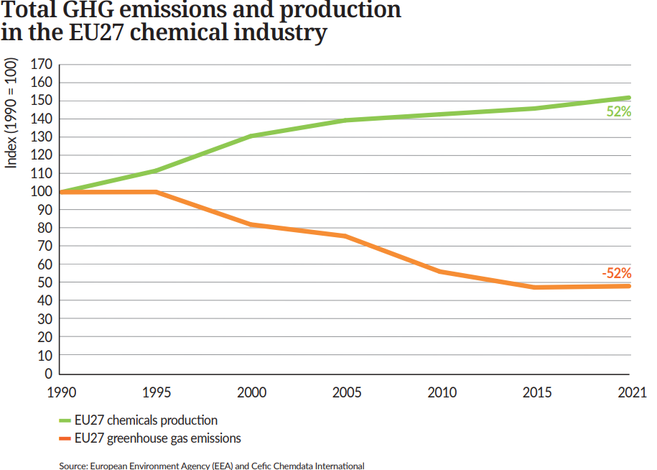
EU27 chemical production and greenhouse gas emissions decouple

Slide 59
EU27 greenhouse gas intensity plummets significantly since 1990

Slide 60
Total number of accidents dropped by over one third in the EU27 chemical industry

Slide 61
Contact : Dr Moncef HADHRI Cefic Industrial Policy - Economic Affairs mha@cefic.be
About Cefic
Cefic, the European Chemical Industry Council, founded in 1972, is the voice of large, medium and small chemical companies across Europe, which provide 1.1 million jobs and account for 14% of world chemicals production. Cefic members form one of the most active networks of the business community, complemented by partnerships with industry associations representing various sectors in the value chain. A full list of our members is available on the Cefic website. Cefic is an active member of the International Council of Chemical Associations (ICCA), which represents chemical manufacturers and producers all over the world and seeks to strengthen existing cooperation with global organisations such as UNEP and the OECD to improve chemicals management worldwide

