Slide 1
The European Chemical industry
Facts and Figures 2024
A vital part of Europe’s Future
January 2025

Slide 2

1. Profile - key figures

Slide 3
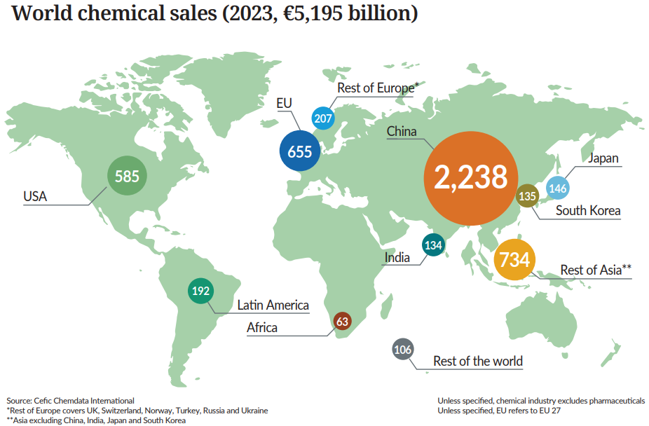
Europe is the second-largest chemical producer in the world

Slide 4
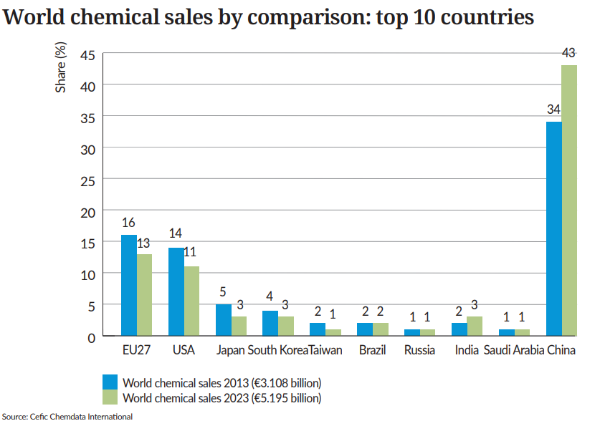
EU27 market share dropped significantly in 10 years

Slide 5
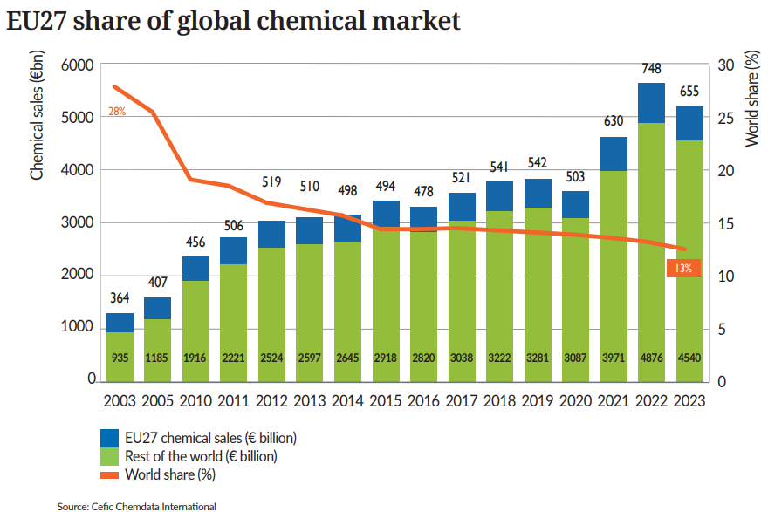
Over 20 years, the EU27 share of global chemical market dropped sharply

Slide 6
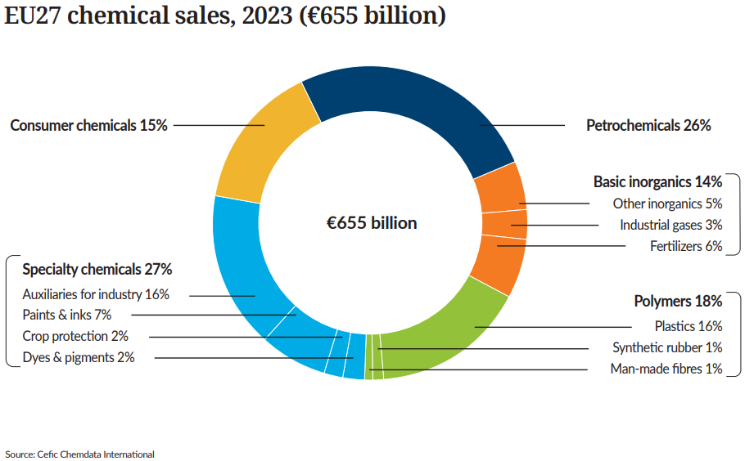
Petrochemicals and specialties account for more than half of EU27 chemical sales

Slide 7
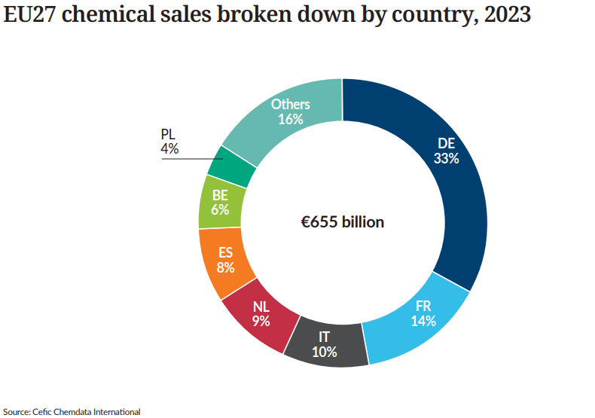
Two thirds of EU27 chemical sales generated in four Member States

Slide 8
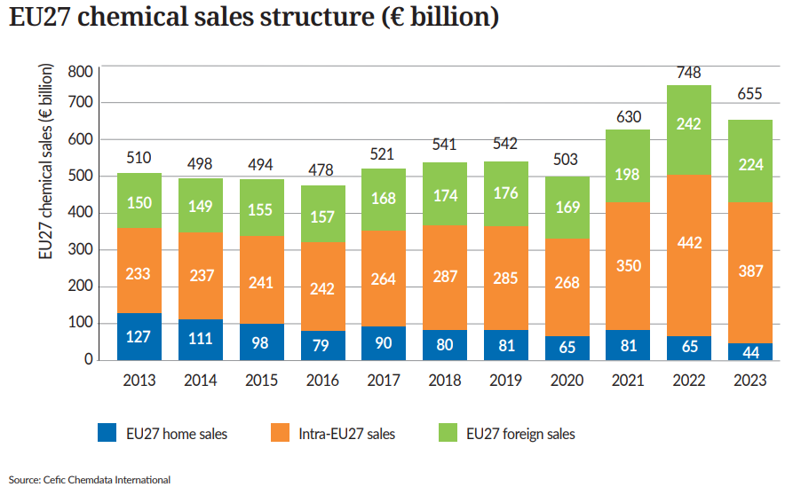
EU27 chemical sales significantly decreased in 2023 vs 2022

Slide 9
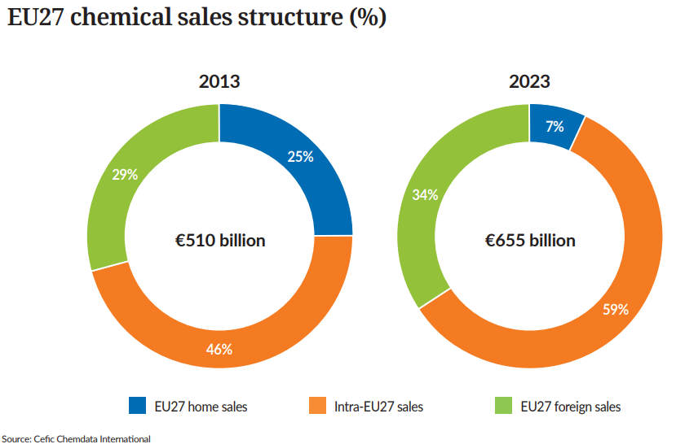
One third of EU27 chemical sales is generated from exports

Slide 10
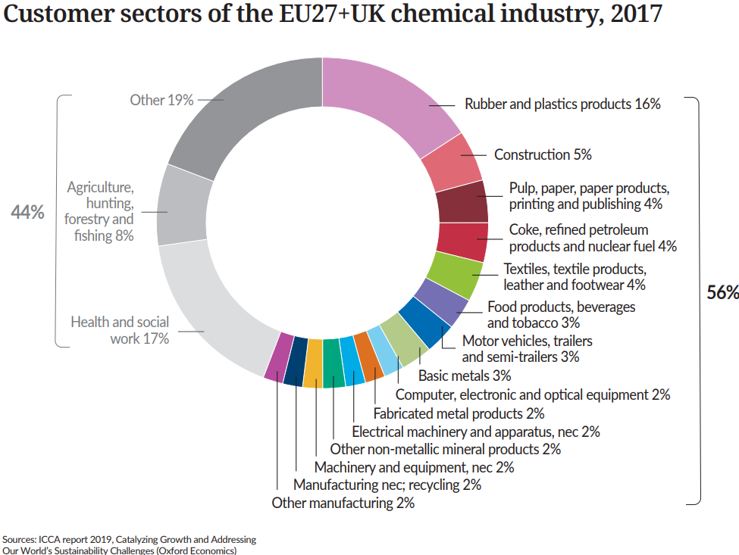
More than half of EU chemicals are supplied to the industry

Slide 11

2. Trade Development

Slide 12
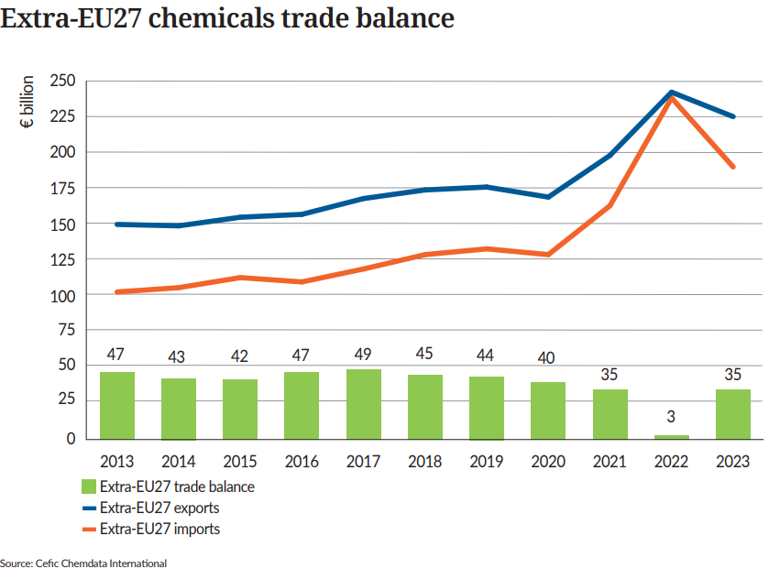
EU27 chemical trade surplus bounced back to 2021 levels

Slide 13
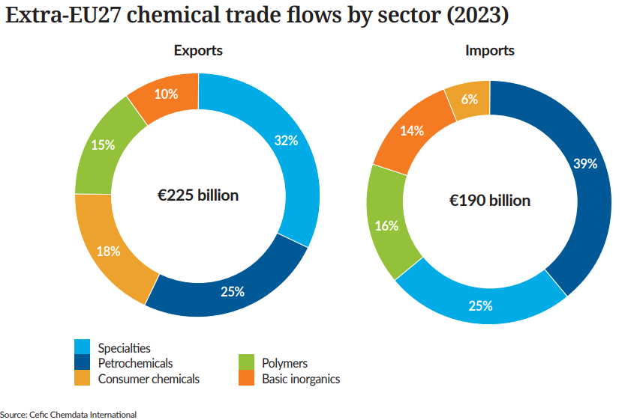
Petrochemicals dominates import & specialty chemicals dominates export in 2023

Slide 14
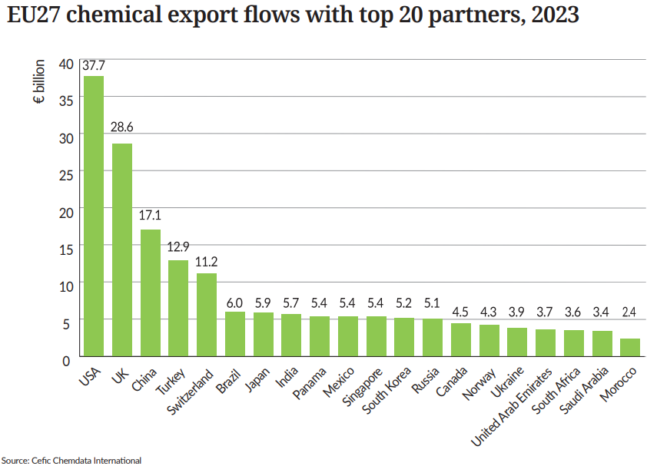
In 2023, US is the first export country for the EU27

Slide 15
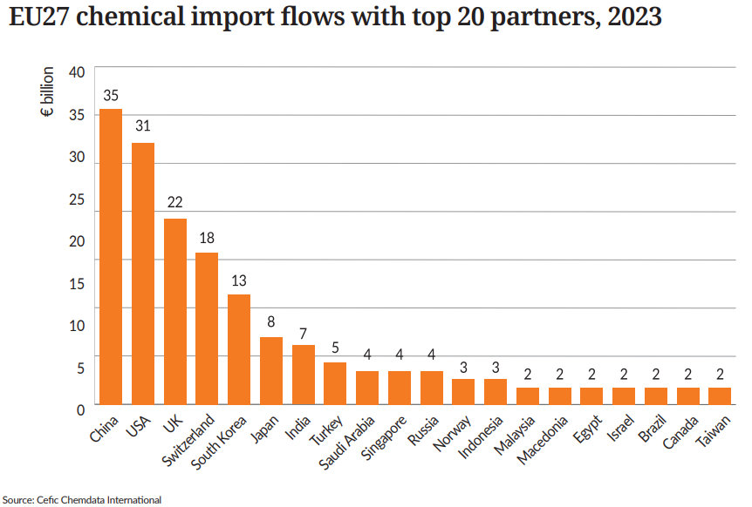
In 2023, China is the first import country for the EU27

Slide 16
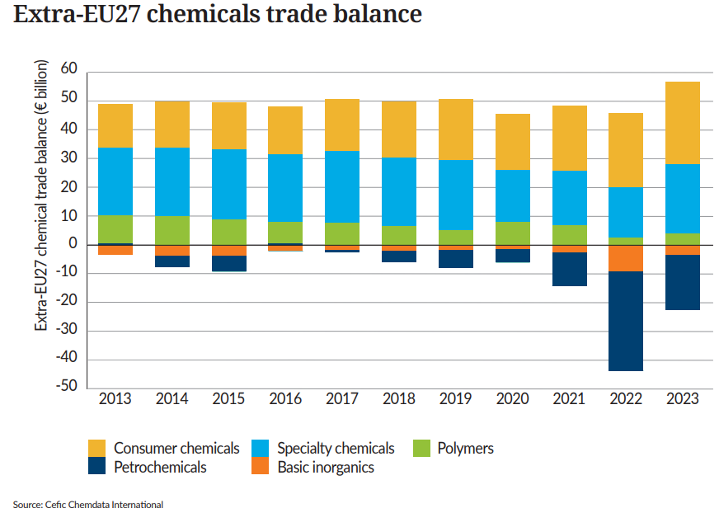
Consumer chemicals contribute most to EU27 chemical trade surplus

Slide 17
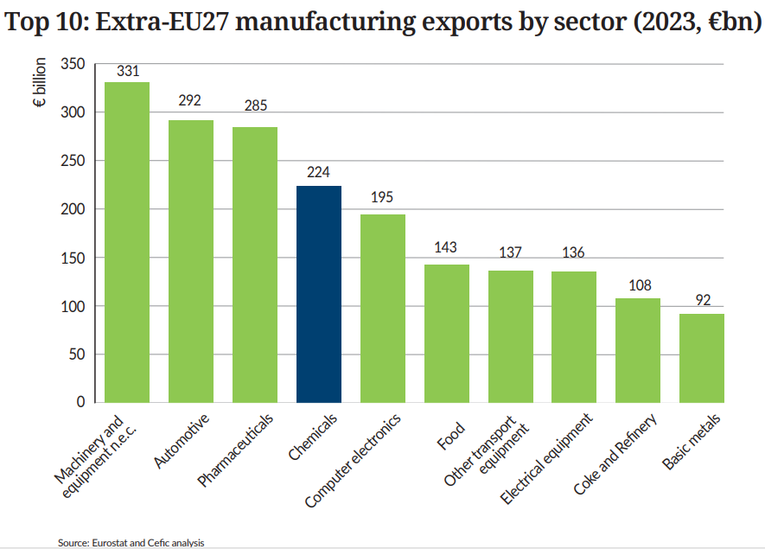
Chemicals accounts for 9.3% of EU27 manufacturing exports

Slide 18
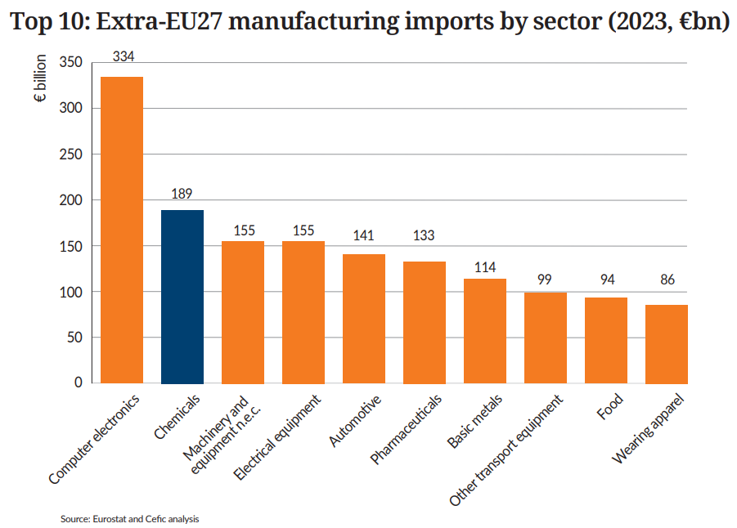
Chemicals accounts for 9.9% of EU27 manufacturing imports

Slide 19
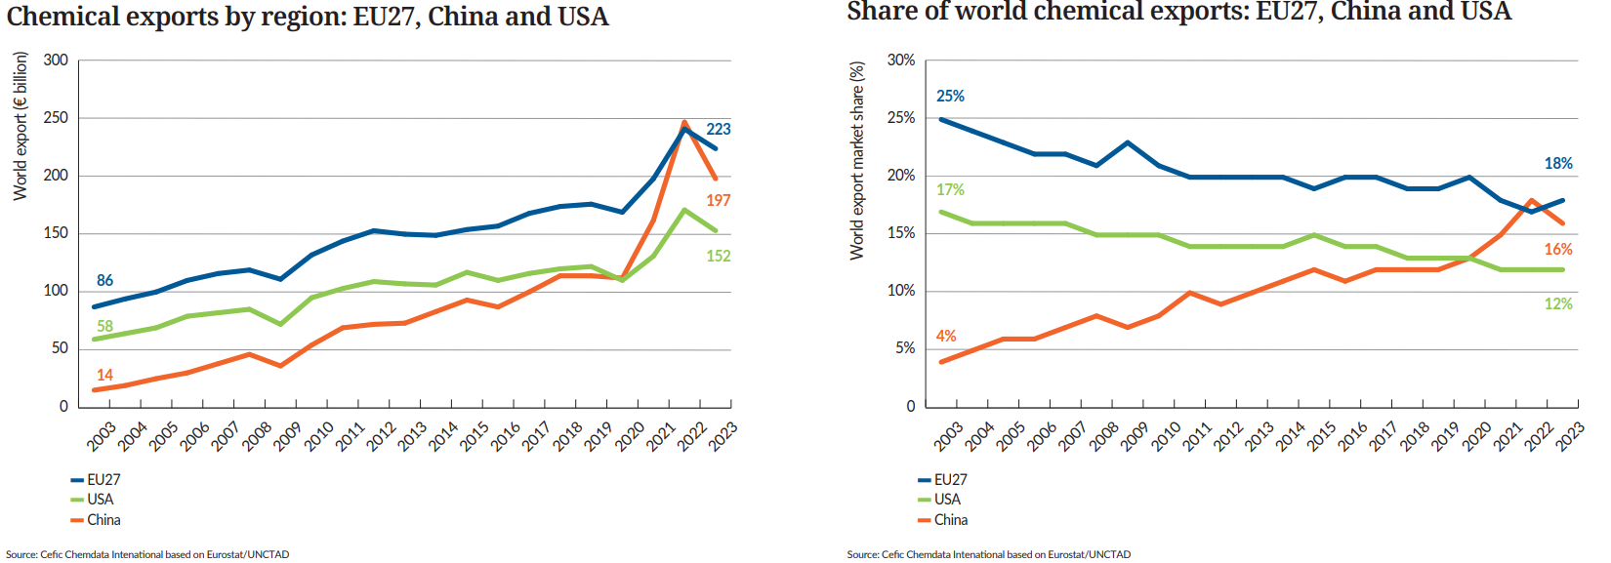
China continues to gain share in the global chemical export
Notes:
China continues to gain share in the global chemical export
Long-term analysis shows that overall growth of chemicals demand and production as well as faster growth in emerging regions is a trend that is expected to continue in the future. With 44% of the world market share, China will continue to hold the top ranking in sales, a position once firmly held by Europe. Although competition in China’s chemical market is currently intensifying and demand growth is weaker than in the past.
A deeper trade analysis is carried out in order to capture the loss of EU27 chemicals exports market share during the years (2002-2022). As shown in the chart above, with 17% in 2022, Europe is still the leader in the global chemicals export market, followed by China (14.4%) and the USA (12.6%). China is really dominating chemicals exports, and gaining intensively export market share at the expense of Europe and the USA. China’s global share went up from 4% in 2022 to 14.4% in 2022, while the EU27’s share dropped significantly from 25% to 17% during the same period.
Chinese chemical exports to high-cost Europe continued to increase over 2023/4 (primarily due to overcapacity in China with a favourable cost position). Europe is still reliant on imports of chemicals from China for several products. Petrochemicals is more concerned than the other chemicals sectors

Slide 20

3. Growth and Competitiveness

Slide 21
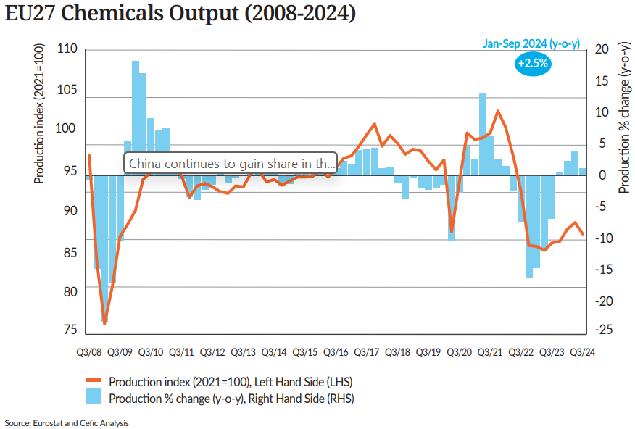
EU27 chemicals output, above the previous year’s level, yet below average

Slide 22
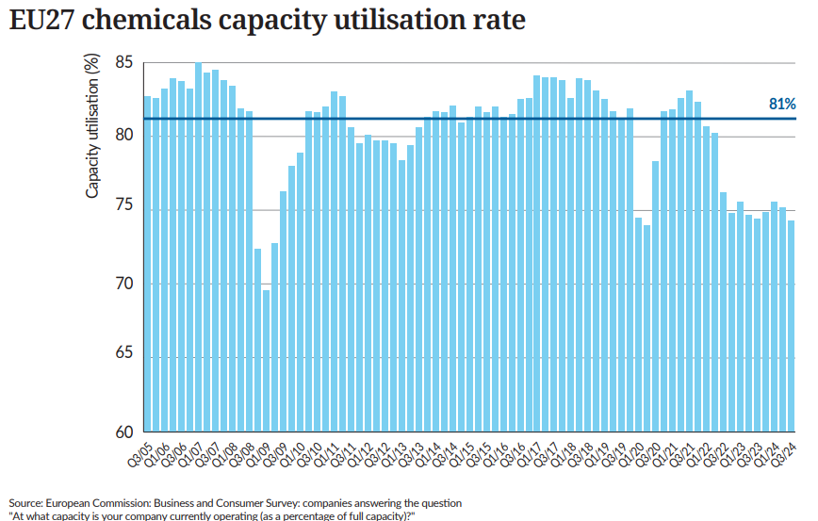
EU27 chemical capacity utilization remains below its long-term average

Slide 23
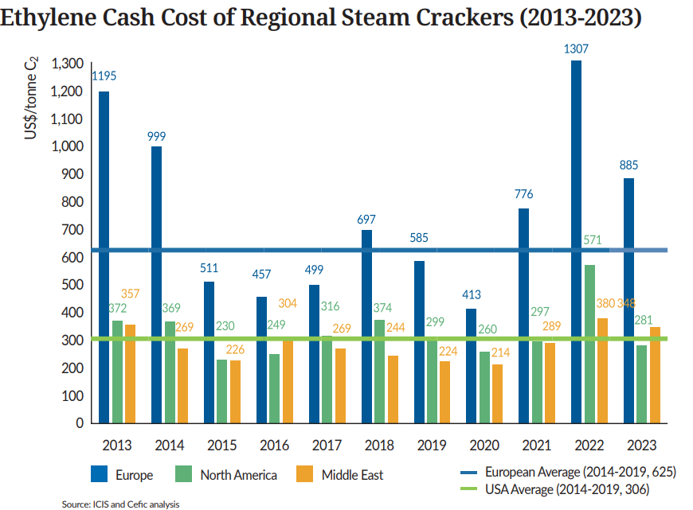
Europe is at a cost disadvantage compared to North America and Middle East

Slide 24
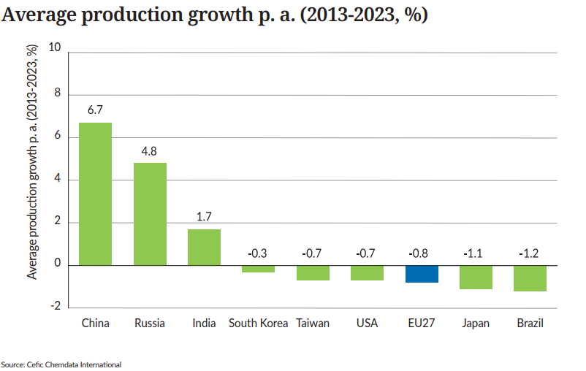
China grows faster than the EU27 and US

Slide 25

4. Our contribution to EU industry

Slide 26
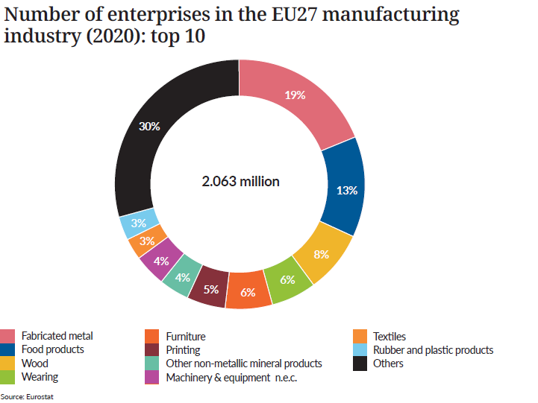
Top 10 sectors account for 70% of total EU27 manufacturing enterprises

Slide 27
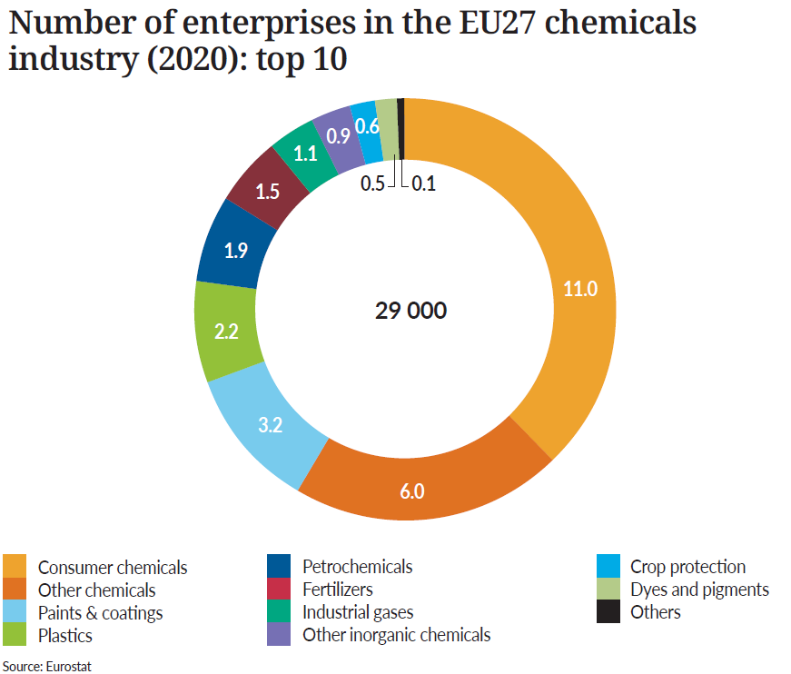
Consumer chemicals has the highest number of chemicals enterprises

Slide 28
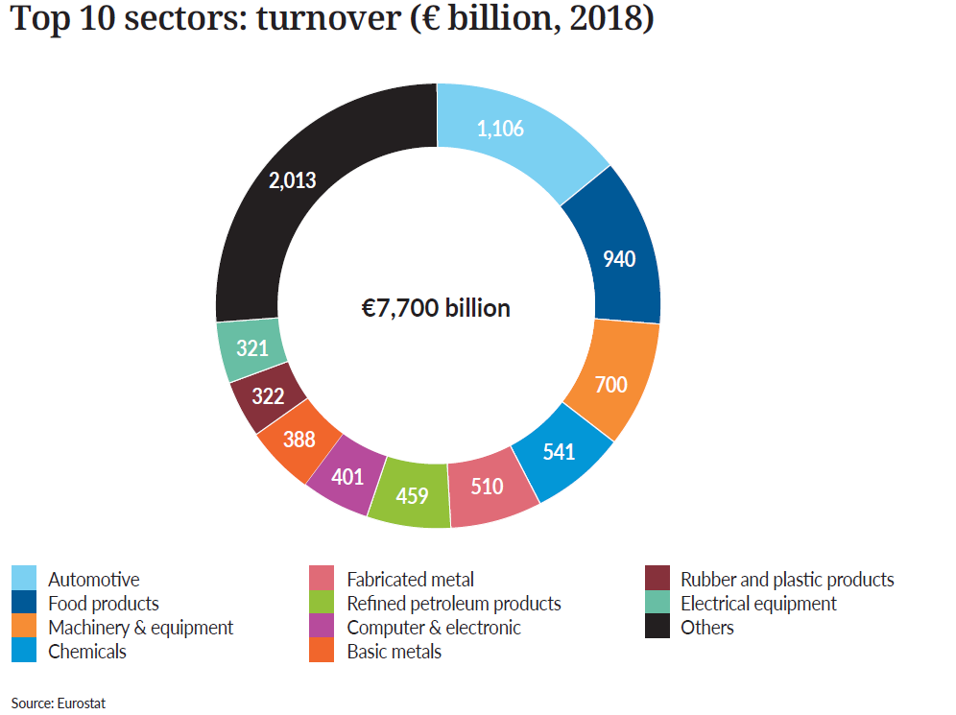
Chemicals is the fourth-largest EU27 manufacturing sector

Slide 29
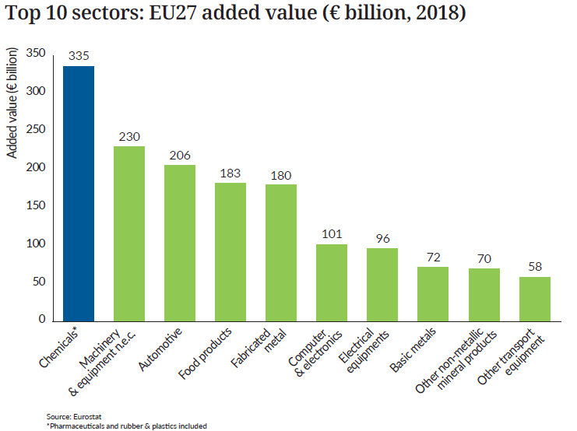
Chemicals* is the leading sector in terms of added value

Slide 30
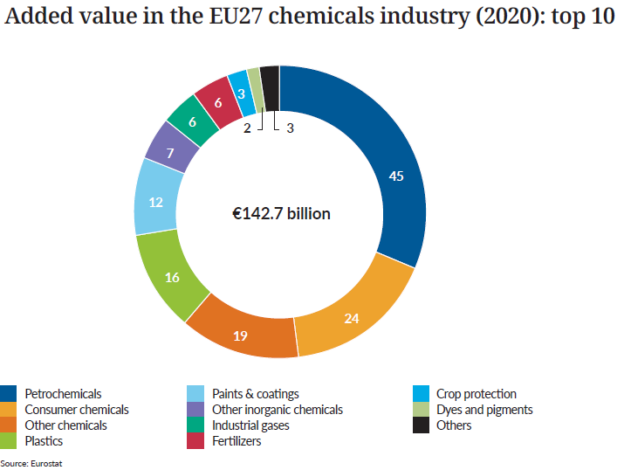
Petrochemicals has the highest added value in EU27 chemicals sector

Slide 31
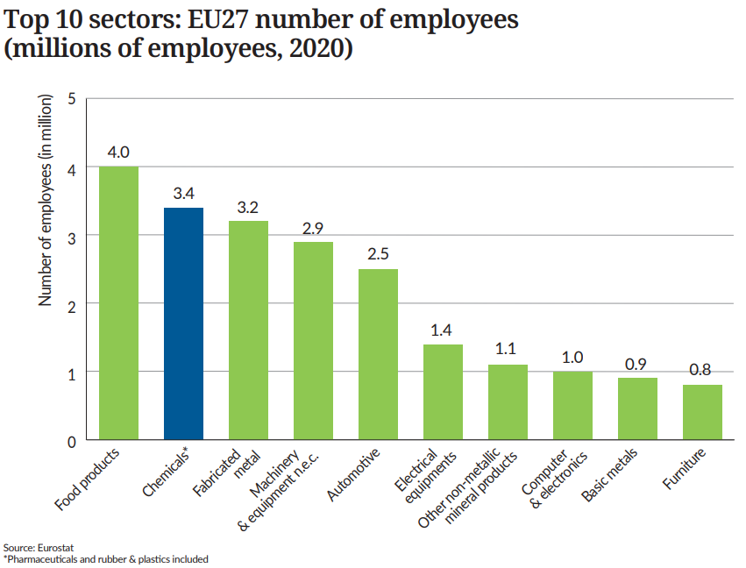
Chemicals* contributes 12% of EU27 manufacturing employment

Slide 32
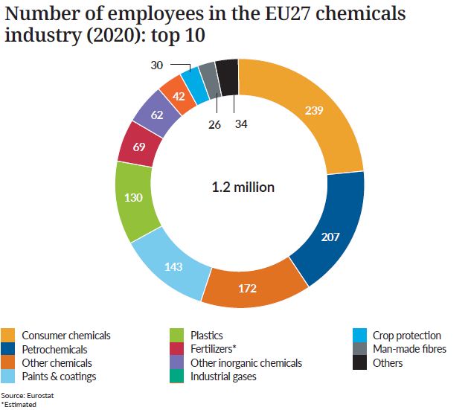
Consumer chemicals is the largest employer in the EU27 chemicals sector

Slide 33
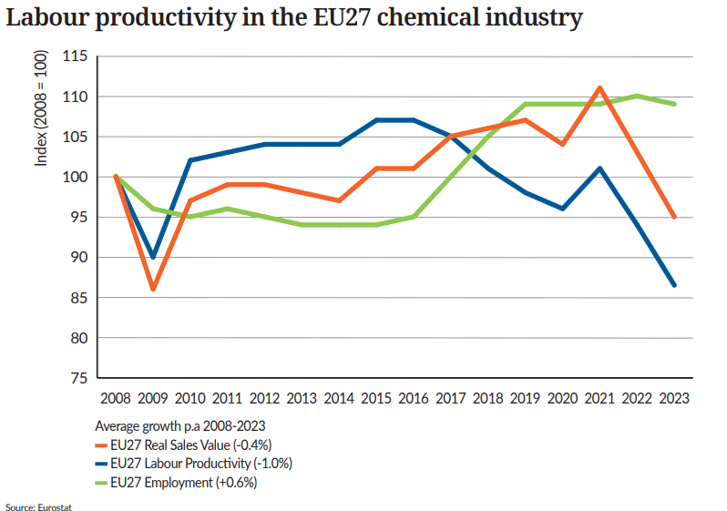
EU27 Labour productivity declines at 1.0%

Slide 34
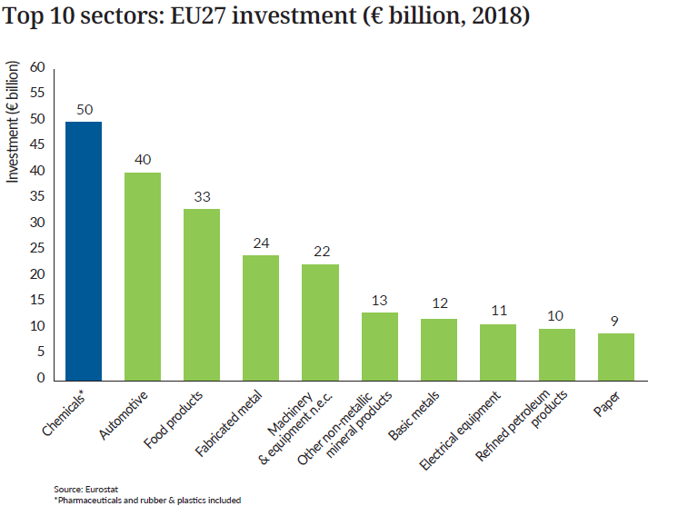
Chemicals* is the largest investor in EU27 manufacturing sector

Slide 35
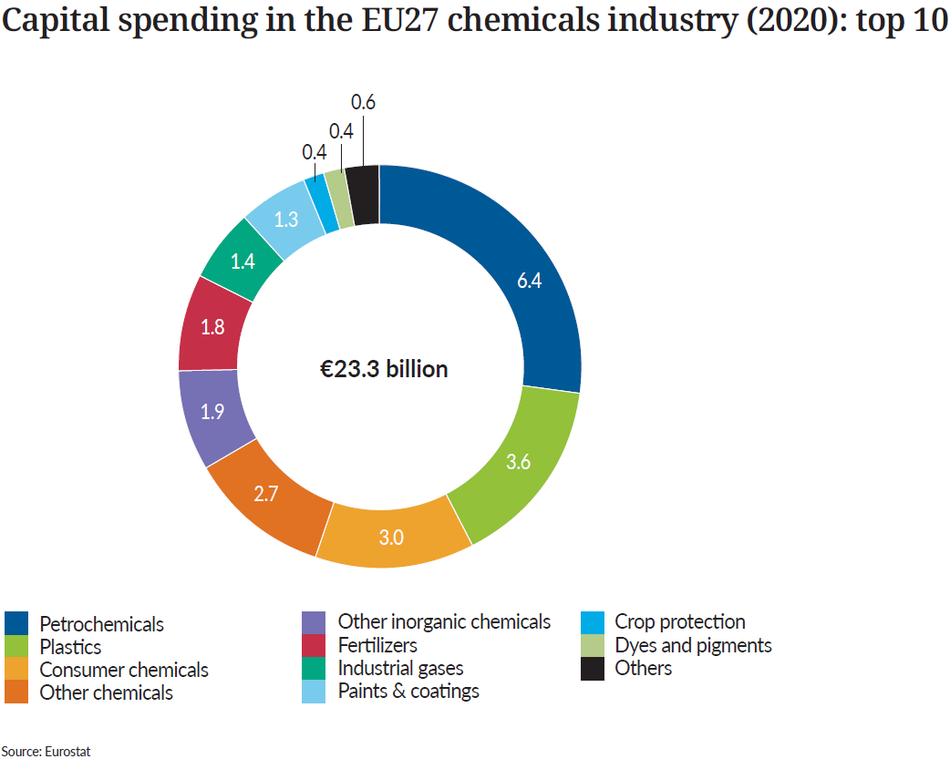
Petrochemicals is the largest investor in the EU27 chemicals sector

Slide 36

5. Energy Consumption

Slide 37
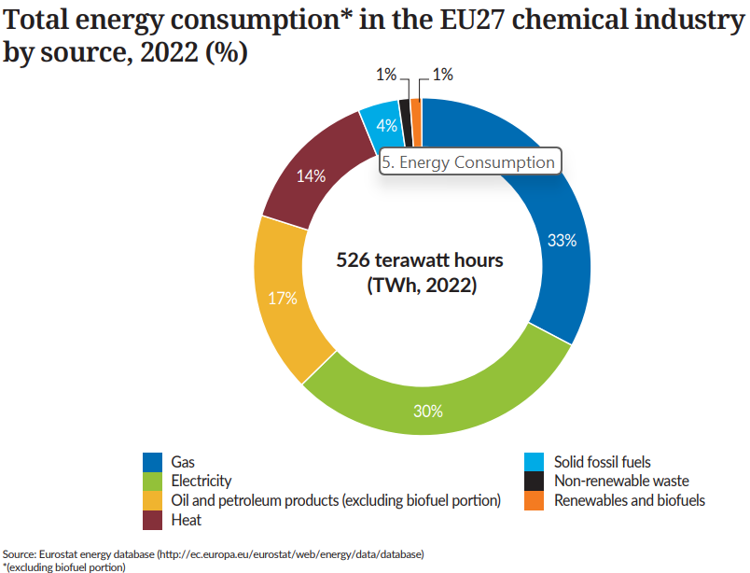
EU27 gas and electricity account for two thirds of total energy consumption

Slide 38
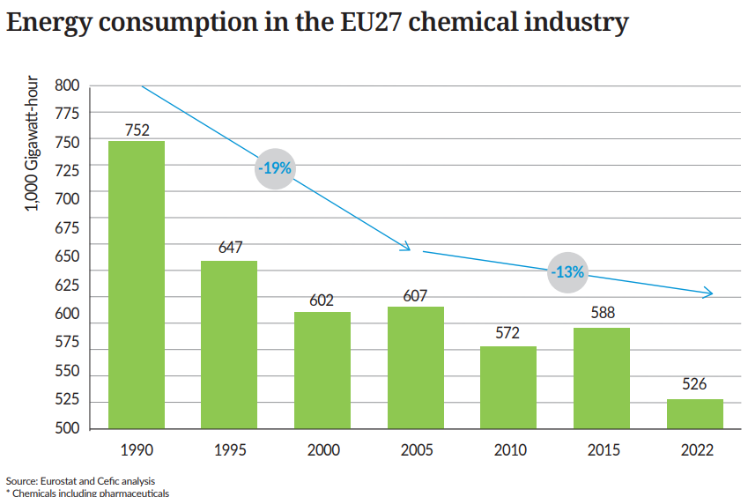
EU27 energy consumption falls 30% since 1990

Slide 39
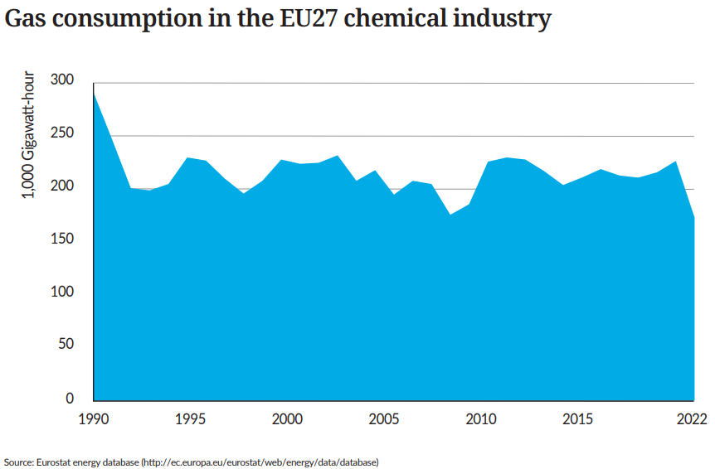
EU27 gas consumption falls 41% since 1990

Slide 40
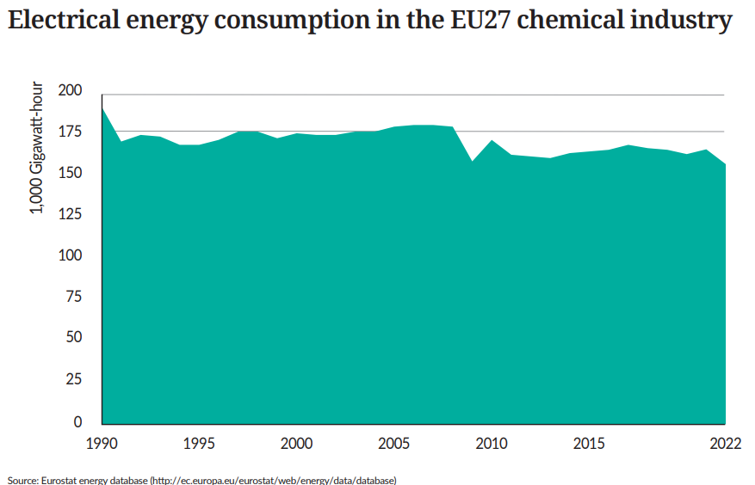
EU27 electrical energy consumption falls 18% since 1990

Slide 41
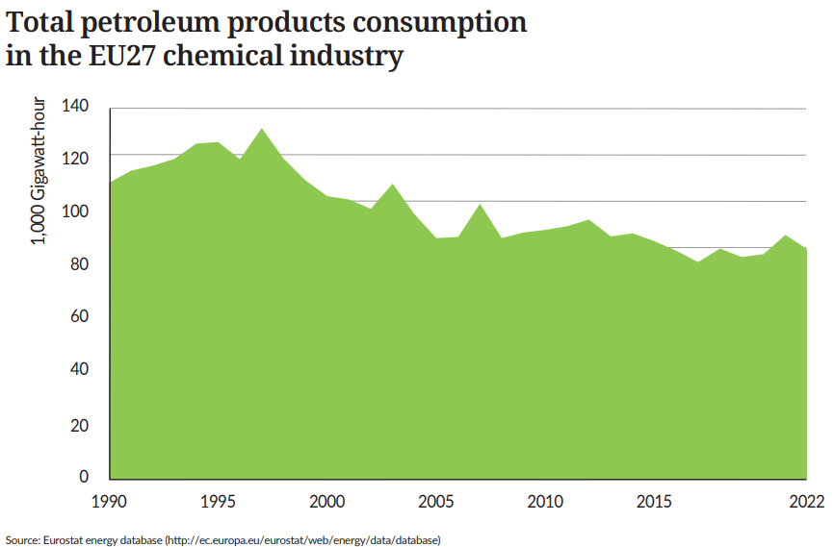
EU27 Total petroleum consumption falls 22% since 1990

Slide 42
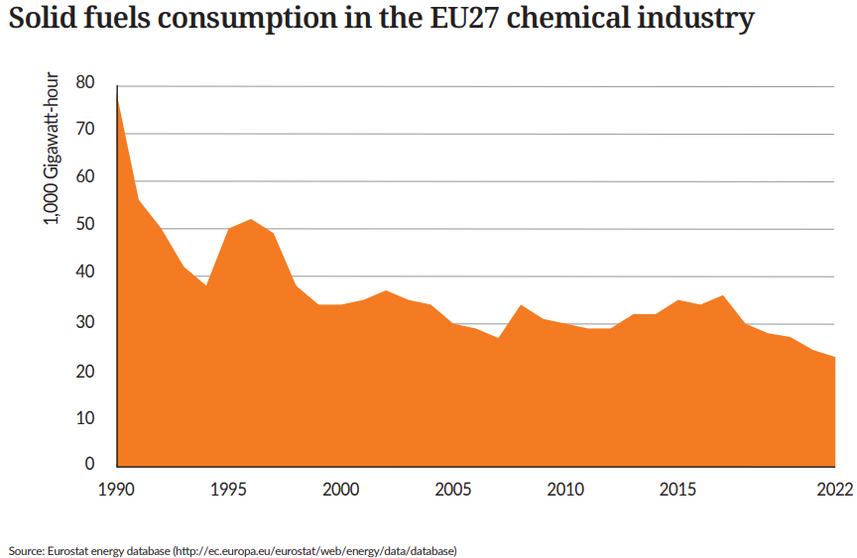
EU27 solid fuels consumption falls 71% since 1990

Slide 43
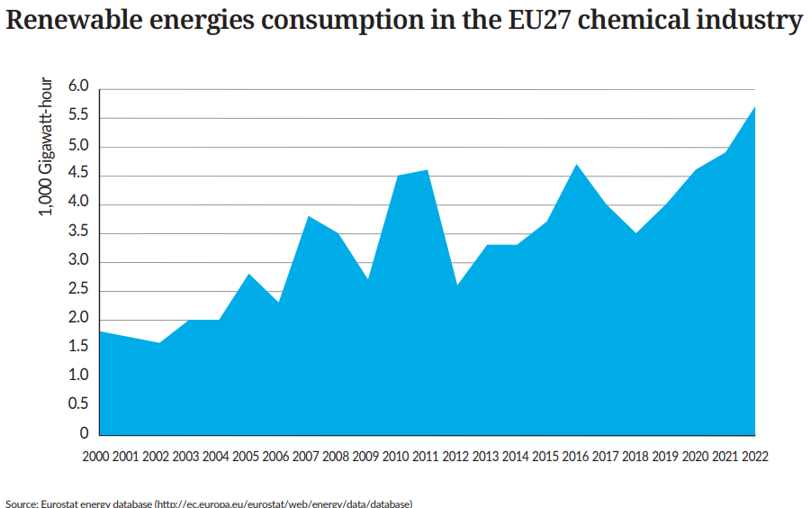
EU27 Renewable energies consumption more than tripled since 2000

Slide 44
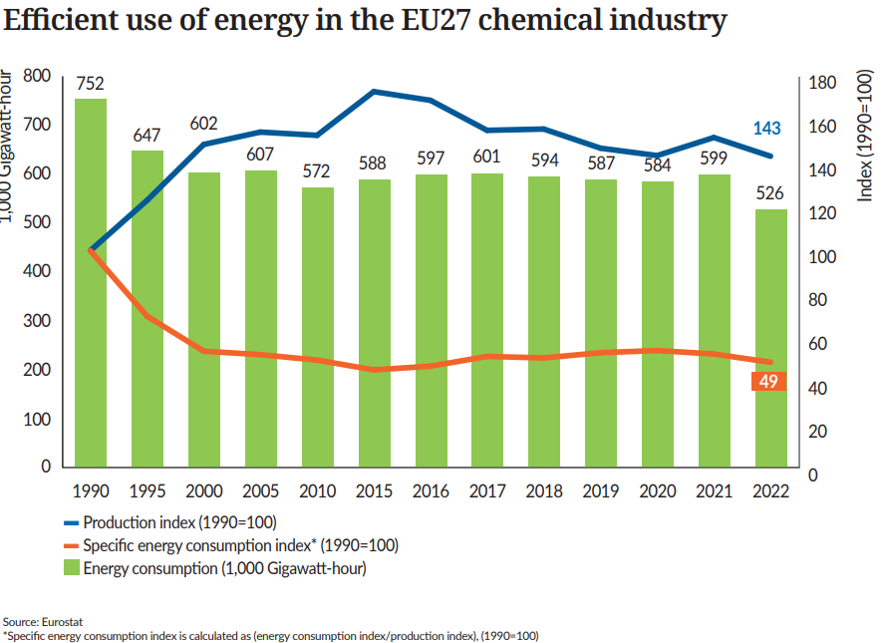
EU27 specific energy consumption* dropped by 51% since 1990

Slide 45
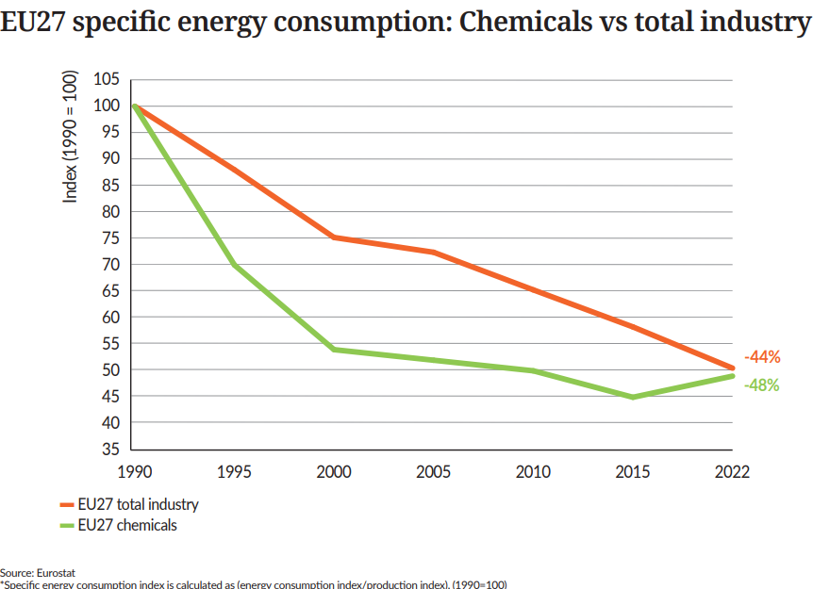
EU27 chemicals performance* is slightly higher than overall industry

Slide 46

6. Capital and R&I Spending

Slide 47
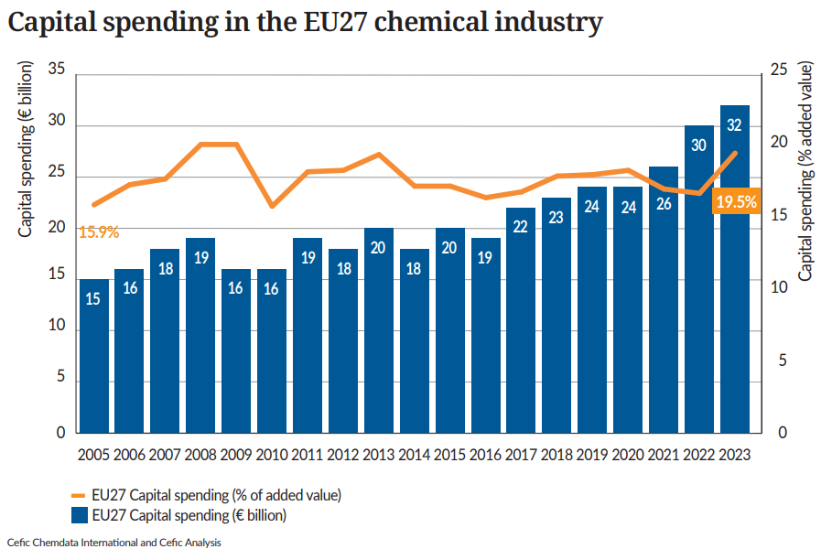
EU27 capital spending increased in 2023 vs 2022

Slide 48
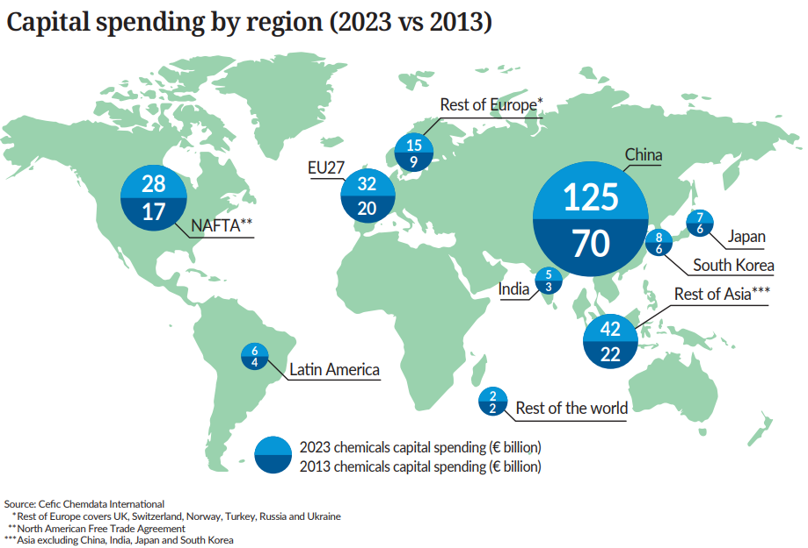
China leads global chemicals investments

Slide 49
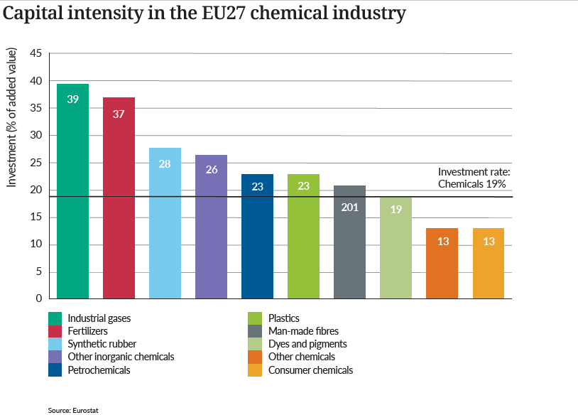
Hight capital intensity in the EU27 chemical sector

Slide 50
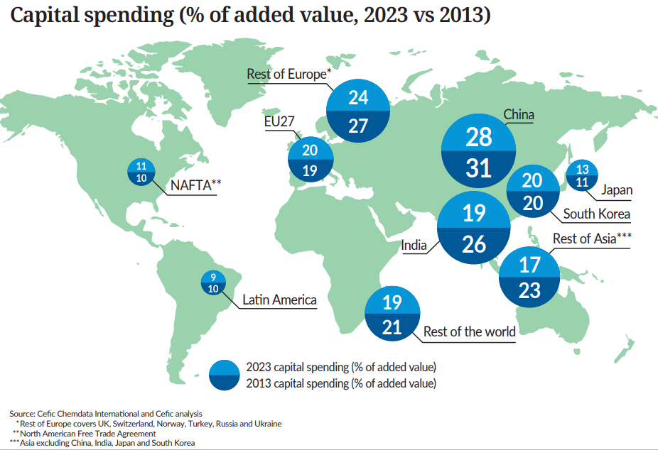
European capital intensity below China

Slide 51
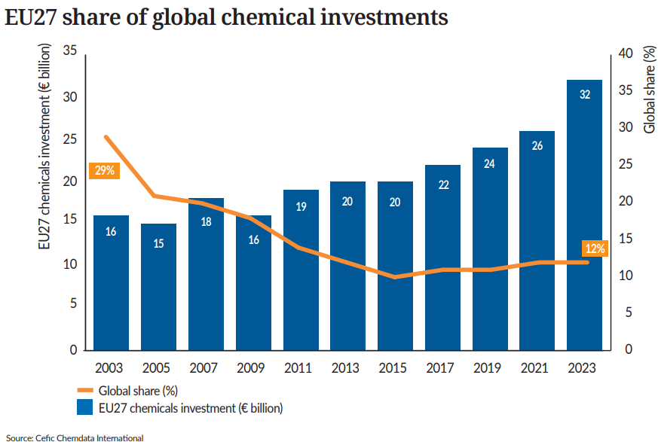
EU27 loses more than 50% of its investment market share vs 2003

Slide 52
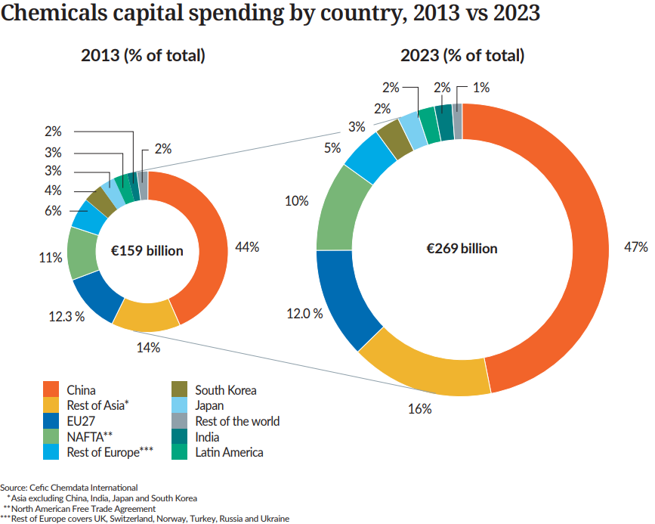
China dominates capital spending

Slide 53
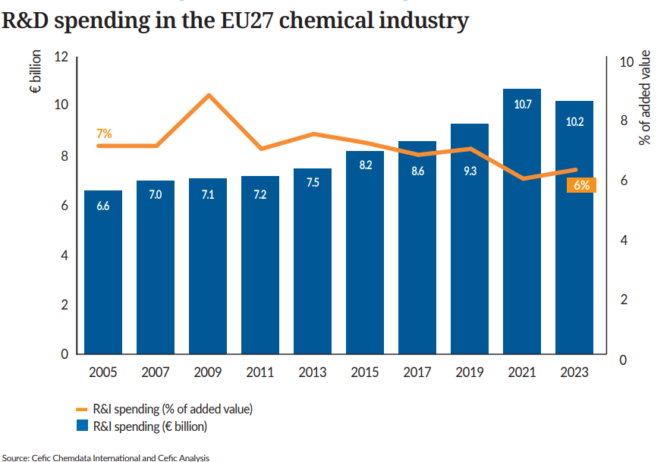
EU27 R&I spending reaches the second highest level in 2023

Slide 54
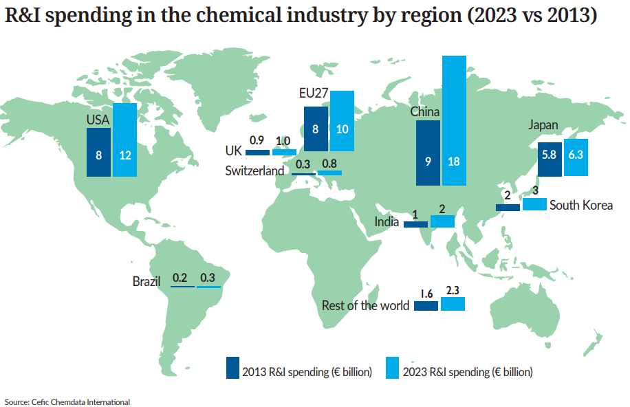
EU27 is the third-largest R&I investor in the world in 2023

Slide 55
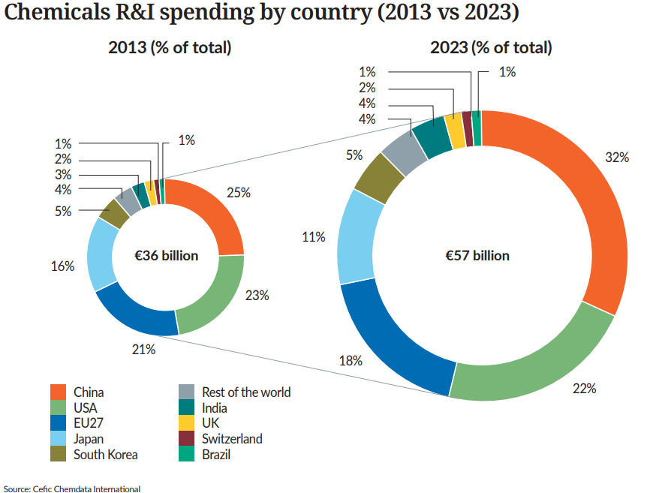
Decreasing share of R&I spending for the EU27, USA and Japan

Slide 56

7. Environmental Performance

Slide 57
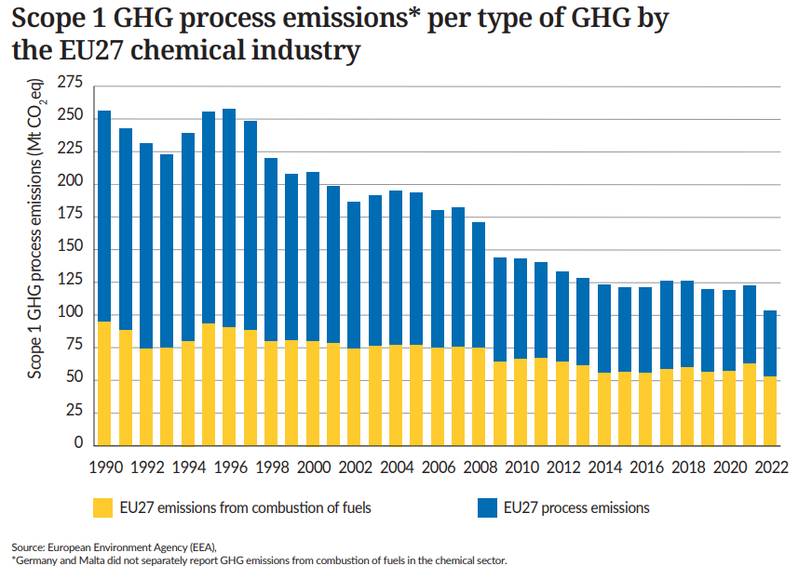
EU27 scope 1 GHG emissions* fall 60% since 1990

Slide 58
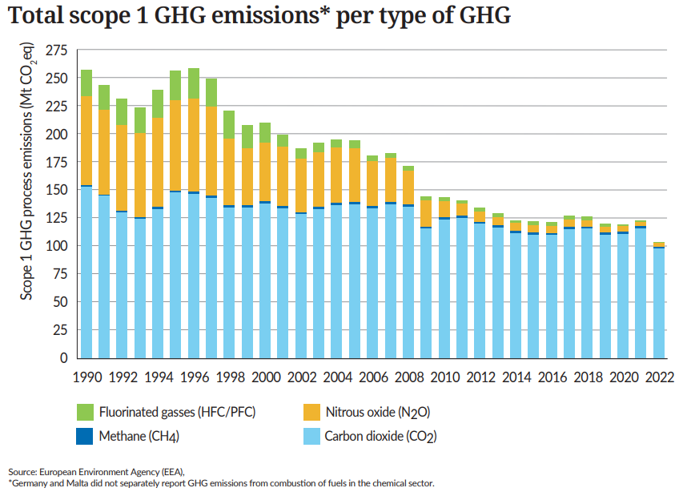
EU27 scope 1 GHG emissions* fall by 153 million tonnes (CO2) since 1990

Slide 59

EU27 chemical production and greenhouse gas emissions decouple

Slide 60

EU27 greenhouse gas intensity decreased significantly since 1990

Slide 61
Contact :
Dr Moncef HADHRI
Cefic Industrial Policy - Economic Affairs mha@cefic.be
About Cefic
Cefic, the European Chemical Industry Council, founded in 1972, is the voice of large, medium and small chemical companies across Europe, which provide 1.2 million jobs and account for 13% of world chemicals production. Cefic members form one of the most active networks of the business community, complemented by partnerships with industry associations representing various sectors in the value chain. A full list of our members is available on the Cefic website.
Cefic is an active member of the International Council of Chemical Associations (ICCA), which represents
chemical manufacturers and producers all over the world and seeks to strengthen existing cooperation with global organisations such as UNEP and the OECD to improve chemicals management worldwide

