Slide 1

Chemical Industry in Europe – Trends
Cefic Industrial Policy Programme

Slide 2
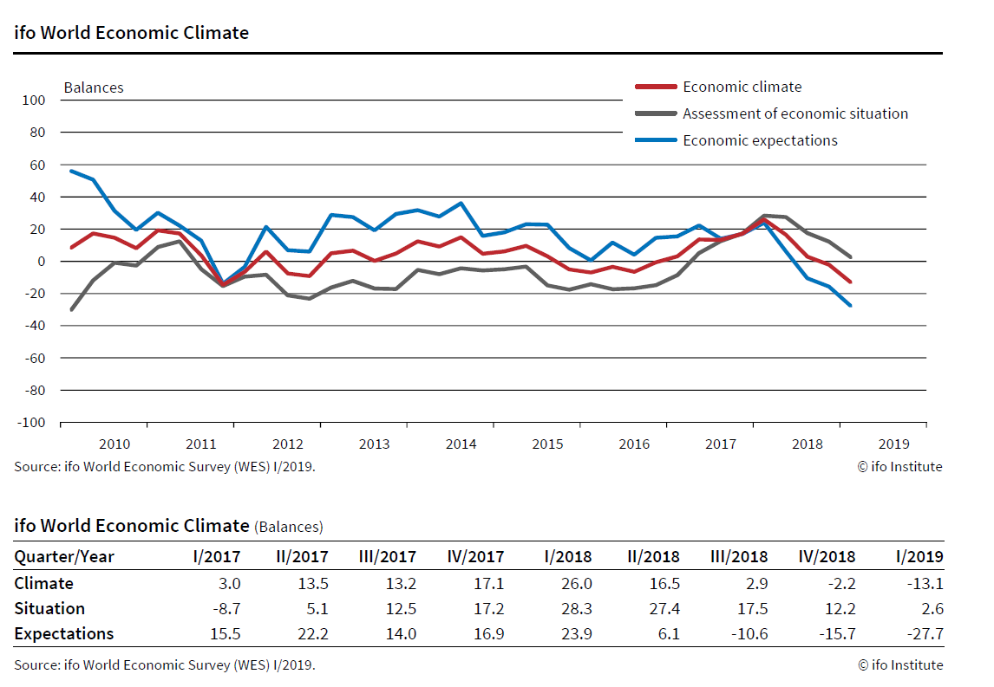
World Economic Climate Suffers Another Setback
The ifo World Economic Climate deteriorated
for the fourth time in succession
Notes:
ifo World Economic Climate Suffers Another Setback
Munich, February 11, 2019 – The ifo World Economic Climate deteriorated for the fourth time in succession.
In the first quarter, the indicator dropped from -2.2 points to -13.1 points. Expectations and assessments ofthe current economic situation dropped significantly, although experts’ overall view is still slightly positive.The global economy is slowing down more and more.
Deterioration of the economic climate was especially strong in advanced economies. The United States in
particular saw a slump in expectations and assessments, while in the European Union, experts also revised their
estimates significantly downwards.
In contrast, the economic climate in emerging and developing countries remained largely unchanged, after declining sharply over the two previous quarters. The climate cooled significantly in the Middle East and North Africa.
Experts expect weaker growth in private consumption, investment, and world trade. Although a large proportion of respondents still expect short- and long-term interest rates to rise, their share has fallen sharply. They expect the US dollar to depreciate worldwide.
For long time-series in Excel format consult www.cesifo-group.de/langereihen.
Since 1989 the ifo Institute has conducted a quarterly survey in numerous countries on business cycle developments and other
economic factors in the experts’ home countries. The January 2019 survey received responses from 1,293 experts in 122 countries. A
detailed regional analysis appears in the quarterly journal: ifo World Economic Survey. This press release contains advance
information on the most important results.

Slide 3
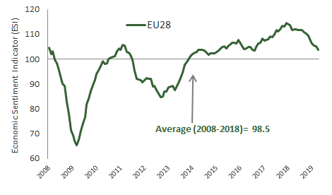
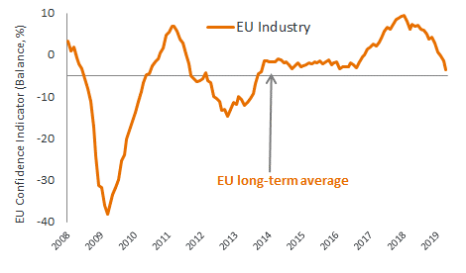
The EU Economic Sentiment Indicator (ESI) decreases markedly
The ESI rose in the Netherlands, while it decreased in France and Italy and, more significantly in Germany and Spain. Data reflects also the strong deterioration of sentiment in the UK (−1.5) and Poland (−3.7). The ESI dropped for the eleventh consecutive time to its lowest level since August 2016
The EU industry confidence took a blow and consumer sentiment weakened.
The negative mood of the industry are mainly driven by trade conflicts, weak dynamics of the economy, ongoing uncertainty on Brexit and the problem of automotive sector in Germany
*EU Commission Report, Business and Consumer Survey, April 2019
Notes:
April 2019: Economic Sentiment decreases markedly in both the euro area and the EU
In April 2019, the Economic Sentiment Indicator (ESI) decreased markedly in both the euro area (by 1.6 points to 104.0) and the EU (by 1.5 points to 103.7).1
Euro area developments
The deterioration of euro-area sentiment resulted from lower confidence in industry, retail trade and, to a lesser extent, in construction and among consumers, while confidence remained unchanged in services. Amongst the largest euro-area economies, the ESI rose only in the Netherlands (+0.4), while it decreased in France (−1.0) and Italy (−1.0) and, more significantly so, in Germany (−1.5) and Spain (−2.6).
The strong decrease in industry confidence (−2.5) resulted from managers' more pessimistic views on all three components, i.e. production expectations, the current level of overall order books and the stocks of finished products. Of the questions not included in the confidence indicator, manufacturers' assessments of the past production deteriorated significantly, too, whereas there was some relief in the appraisals of export order books. Unchanged services confidence (0.0) resulted from managers' more negative views on the past business situation being offset by brighter demand expectations, while their assessment of past demand remained virtually unchanged. The decrease in consumer confidence (−0.7) reflected households’ more pessimistic expectations about their future financial situation and, in particular, the general economic situation, while their assessments of their past financial situation and their intentions to make major purchases remained broadly stable. The strong decline in retail trade confidence (−1.4) was driven by more negative views on both the present and expected business situation, while retailers’ assessment of the adequacy of the volume of stocks remained broadly stable. Decreasing construction confidence (−0.8) reflected managers' more pessimistic employment expectations, while their assessment of the level of order books improved. Finally, financial services confidence (not included in the ESI) fell (−7.7), reflecting strong deterioration in managers' assessment of past demand and the past business situation, while demand expectations improved.
Employment plans saw a significant deterioration in construction and, to a lesser extent, in industry, while employment plans remained broadly unchanged in services and retail trade. Selling price expectations increased slightly in retail trade, while they decreased markedly in industry and construction and remained virtually stable in services. Also consumer price expectations dropped in April.
EU developments
The commensurate decline of the headline indicator for the EU (−1.5) reflects the strong deterioration of sentiment in the largest non-euro area EU economies, the UK (−1.5) and Poland (−3.7). In line with the euro area, EU industry confidence took a blow and consumer sentiment weakened. While the deterioration of EU confidence in retail trade was less marked than in the euro area, EU confidence in construction worsened more strongly.
Yet, EU confidence in services improved slightly. As regards financial services confidence, the drop in the EU aggregate was in line with euro-area developments.
Managers' employment expectations were more optimistic than in the euro area. They remained virtually stable in industry and improved markedly in services and retail trade. In construction, the deterioration of employment expectations was less strong than in the euro area. Price expectations declined in line with those for the euro area in industry and construction; they also decreased in retail trade and services.

Slide 4

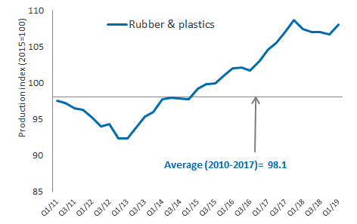
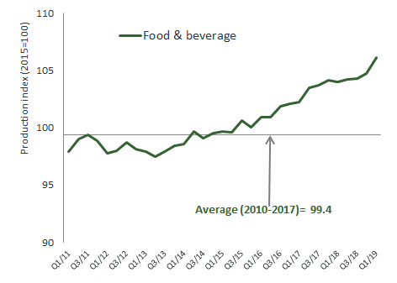

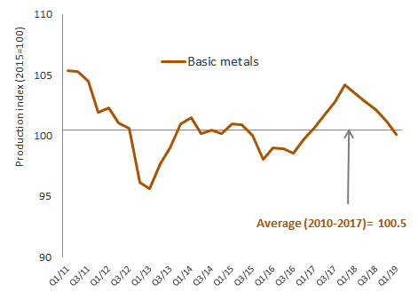
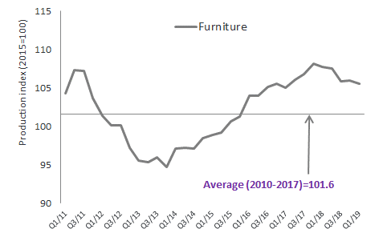


Output in the EU manufacturing sector 1.0% above Q4-2018’s level (y-o-y)
Notes:
.

Slide 5
EU customers: Heterogenous business profile
Source: Eurostat data and Cefic analysis May 2019
Notes:
.

Slide 6
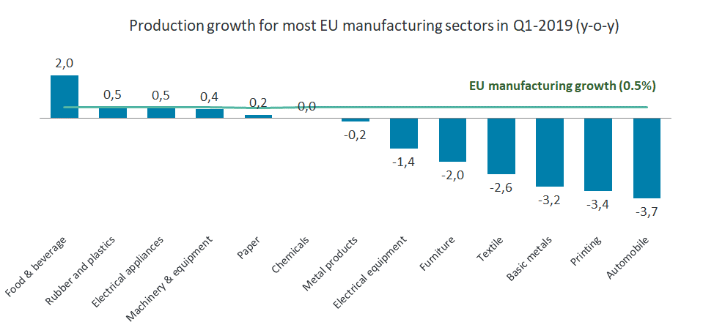
Output in the EU manufacturing sector 0.5% above the previous year’s level (y-o-y)
Demand for the EU chemicals industry was weak. Output in key customer industries was significantly below the previous year’s level
Source: Eurostat data and Cefic analysis May 2019
Notes:
.

Slide 7
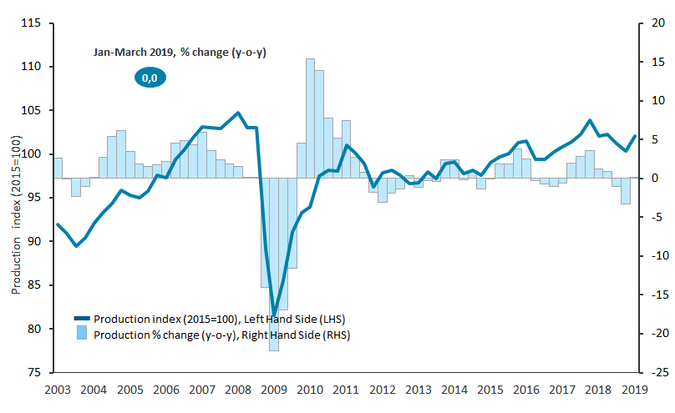
Chemicals output went up by 1.7% in Q1-2019 compared to Q4-2018
Good start of the year 2019.
Output in Q1-2019 was at the same level as in Q1-2018
After a period of declining output growth rates were positive in the beginning of 2019. The modest demand of key customers sectors slowed growth of chemicals
Source: Eurostat data and Cefic analysis May 2019
Notes:
.

Slide 8
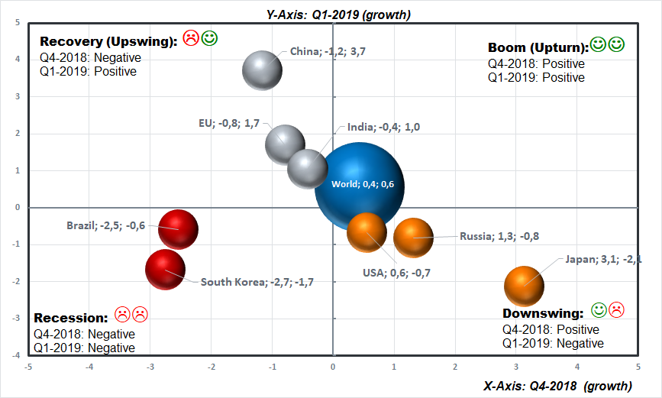
World Chemicals Sector: Business Cycle Clock
Brazil and South Korea are in (technical) recession. Less momentum in investment & exports in South Korea impacted the industry’s development. The EU, China and India are in the “recovery” phase of the business cycle (upswing). The USA, Japan & Russia showed negative trend in Q1-19.
Notes:
In Russia, the VAT increase should be an additional strain on consumption

Slide 9
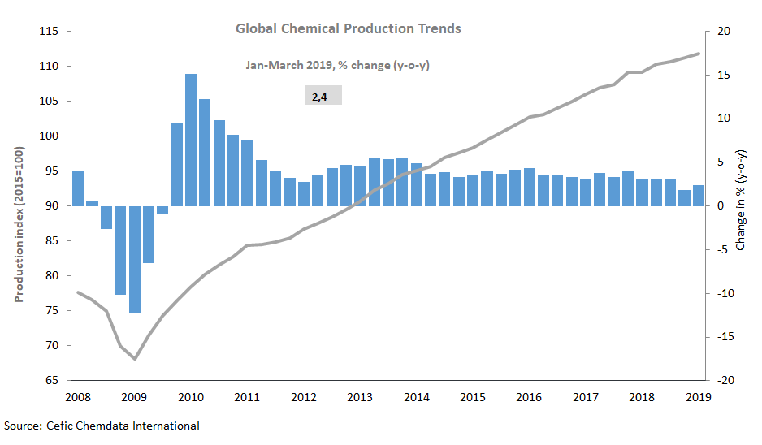
Global chemicals output went down by less than 1% in Q1-2019 compared to Q4-2018
Global chemicals output in Q1-2019 was 2.4% above the previous year’s level. Compared to Q4-2018, output grew by less than 1%.
Global production trend of the chemicals business continued to lose momentum
Notes:
.

Slide 10

Contact details

