Slide 1

Cefic Facts and Figures 2025
To replace the background image:
1/Go to Slide Master (Menu “View”)
2/Right-click on the image
3/Select “Replace image…”
4/Close the Slide Master
Dr Moncef Hadhri
Catherine Tuerlinckx

Slide 2

1. Profile - key figures

Slide 3
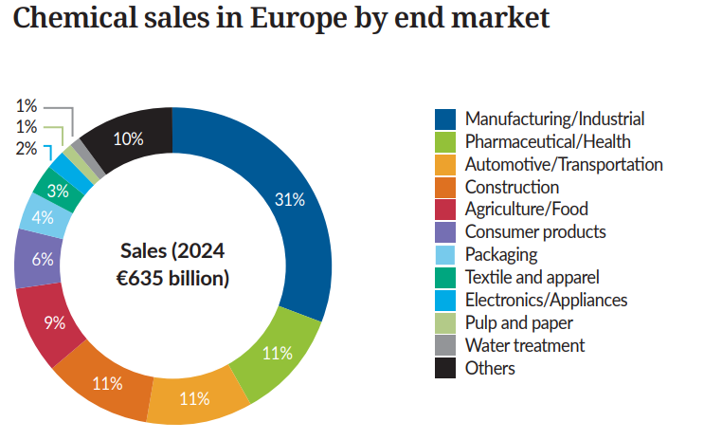
The chemical industry is a major supplier to key manufacturing sectors
Source: Cefic-Advancy Joint Study: The Competitiveness of the European Chemical Industry

Slide 4
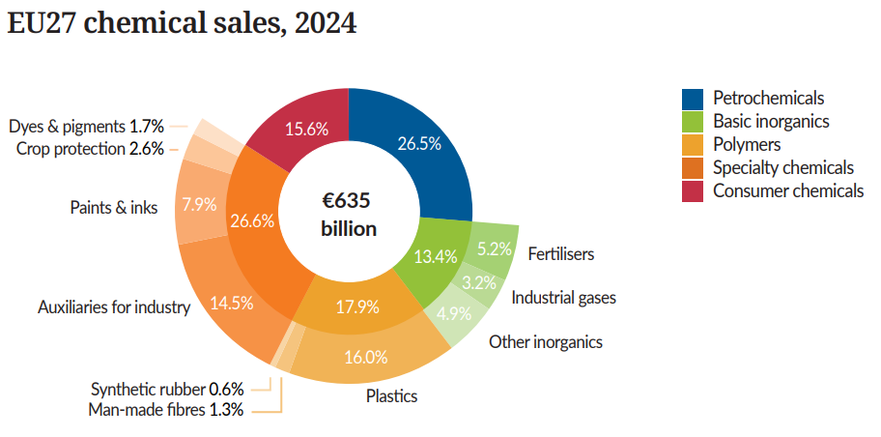
Petrochemicals and specialties account for more than half of EU27 chemical sales
Source: Cefic Chemdata International

Slide 5
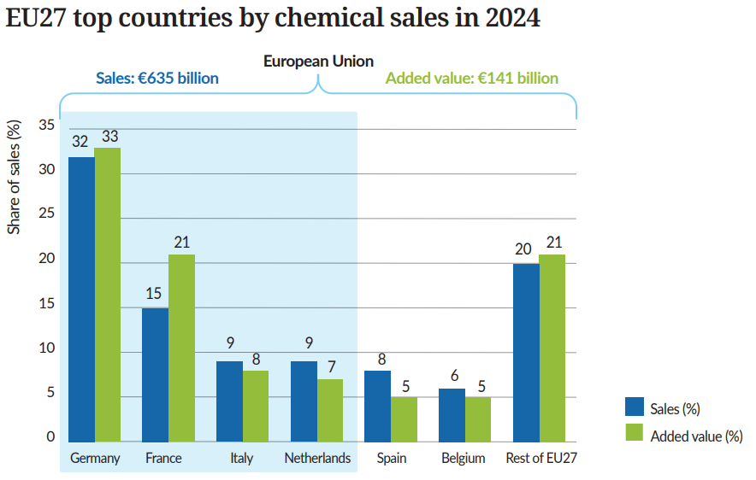
Four Member States drive two-thirds of EU27 chemical sales
Source: Cefic Chemdata International

Slide 6
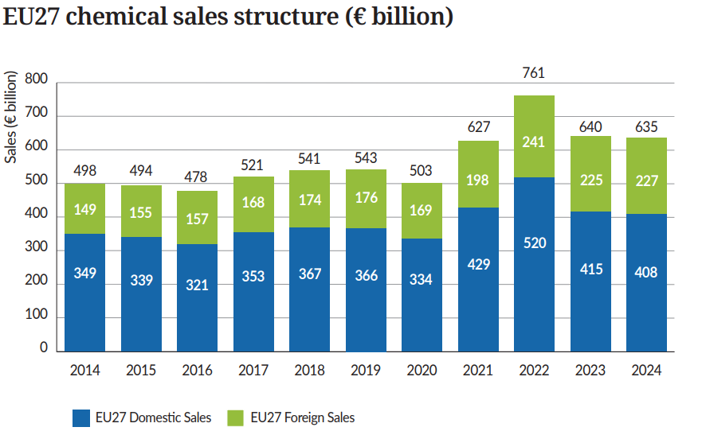
EU27 chemical sales slightly decreased in 2024 vs 2023
Source: Cefic Chemdata International

Slide 7
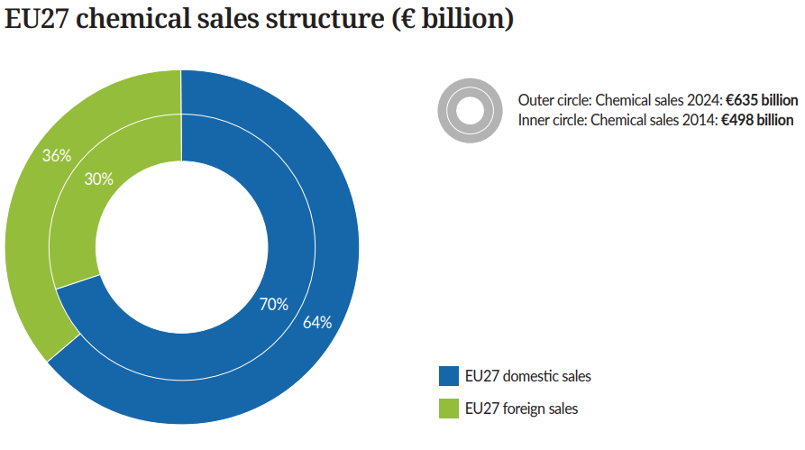
After one decade, foreign sales account for one third of EU27 chemical sales
Source: Cefic Chemdata International

Slide 8
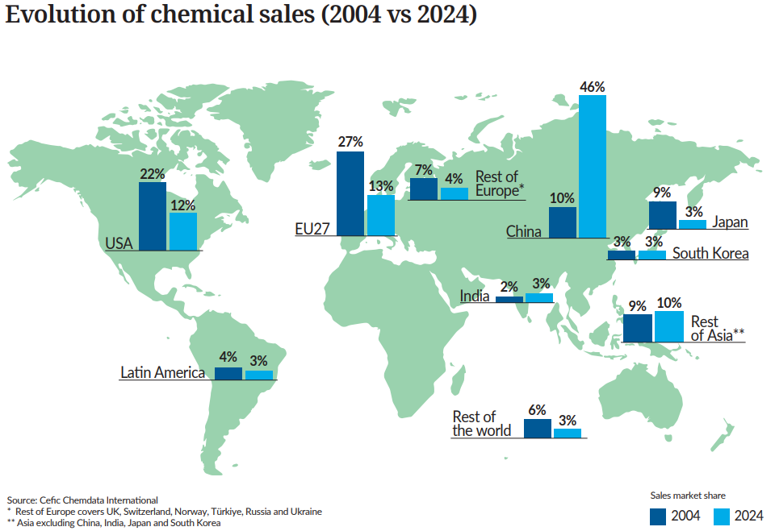
China overtakes Europe and the US as global leader in chemical sales

Slide 9
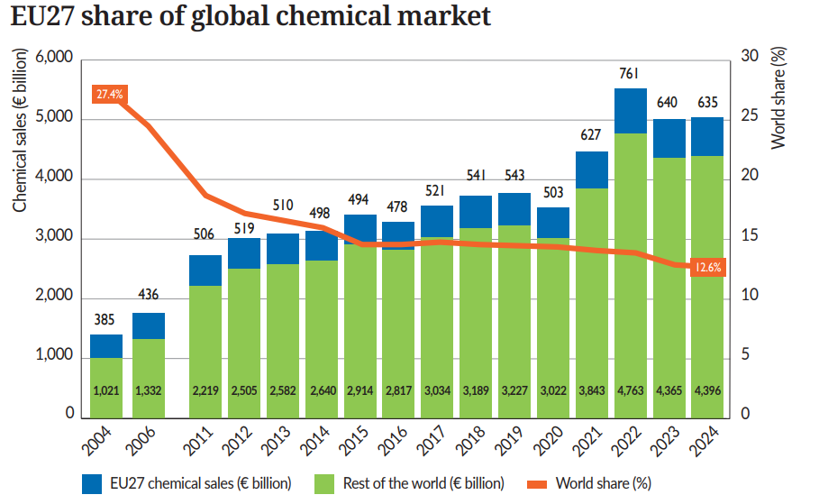
EU27 chemical sales dropped sharply in a growing global market
Source: Cefic Chemdata International

Slide 10
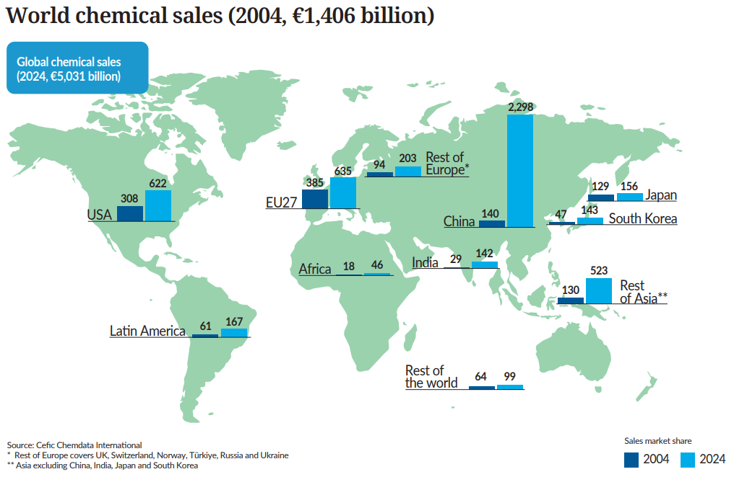
Global chemical sales 2024 are 3.6 times higher than in 2004

Slide 11

2. Trade Development

Slide 12
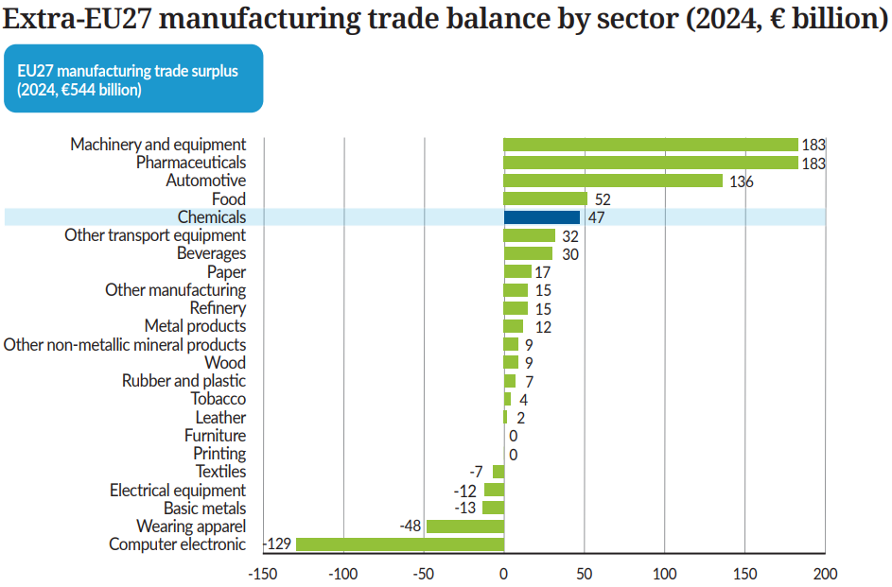
Chemicals are a key contributor to EU27's trade balance (€47 bn)
Source: Cefic analysis based on Eurostat data

Slide 13
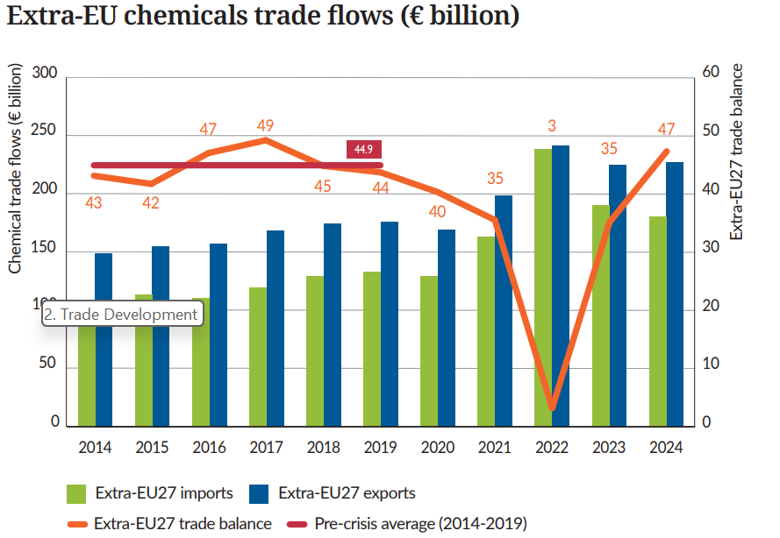
EU27 chemical trade surplus slightly above pre-crisis levels (2014-2019)
Source: Cefic analysis based on Eurostat data

Slide 14
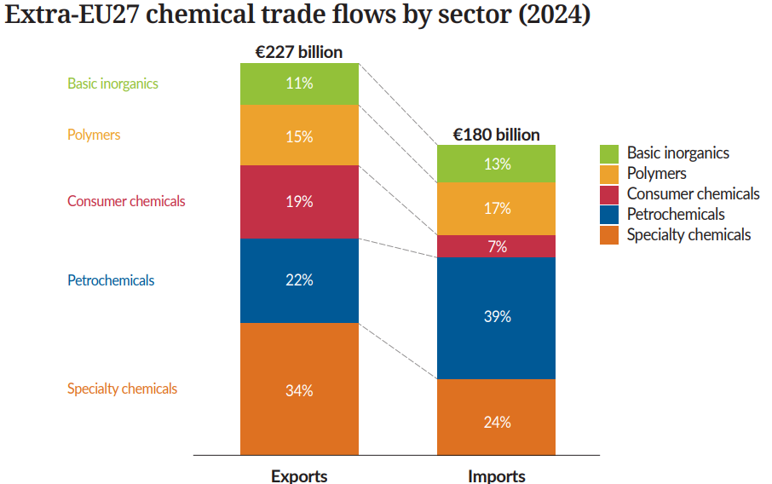
Specialty chemicals dominates export & petrochemicals dominates import in 2024
Source: Cefic Chemdata International

Slide 15
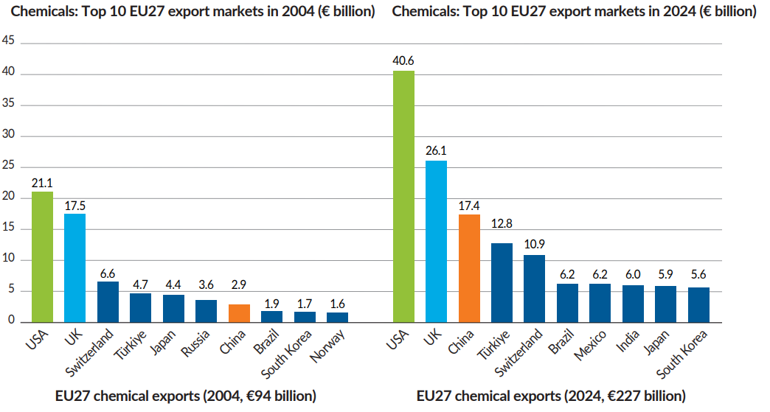
In 2024, US remains the primary export country for the EU27
Source: Cefic analysis based on Eurostat data

Slide 16
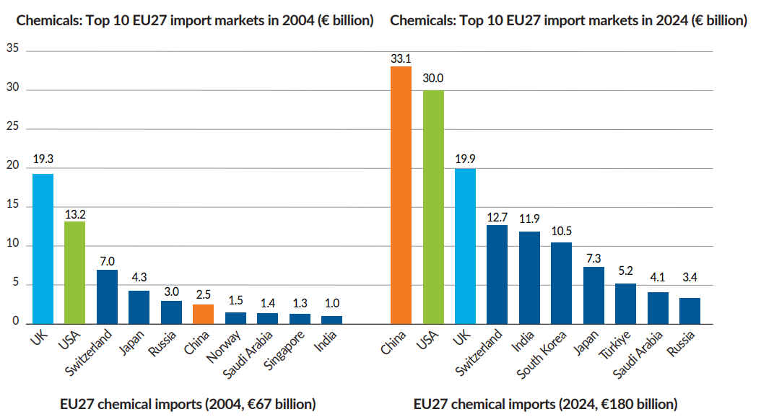
In 2024, China is now the primary import country for the EU27
Source: Cefic analysis based on Eurostat data

Slide 17
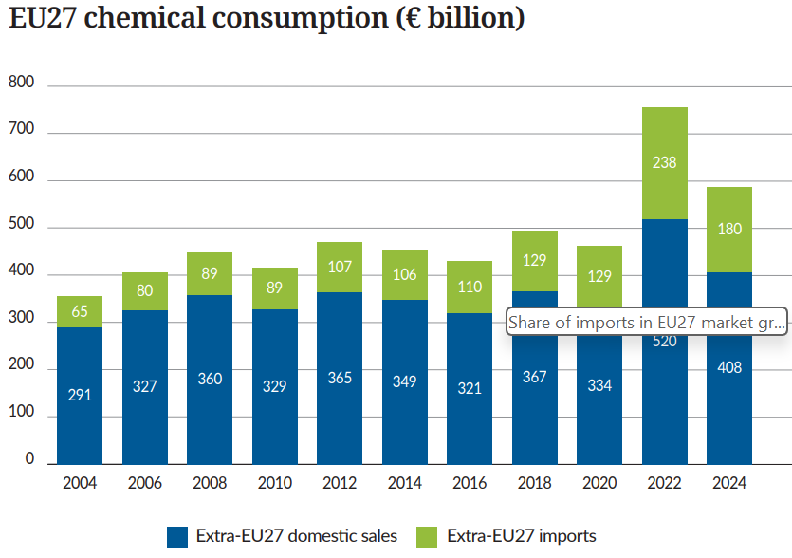
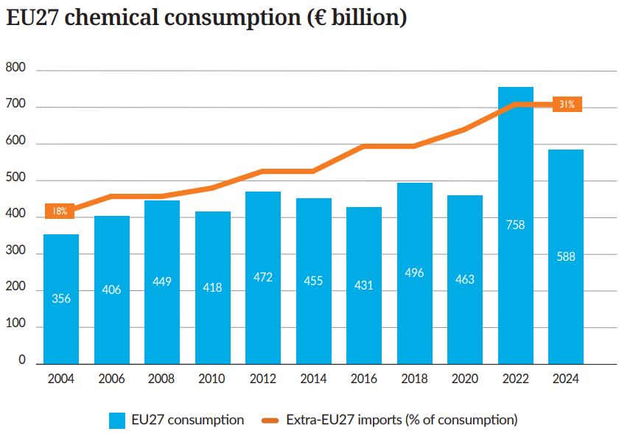
Share of imports in EU27 market grew significantly
Source: Cefic Chemdata International

Slide 18
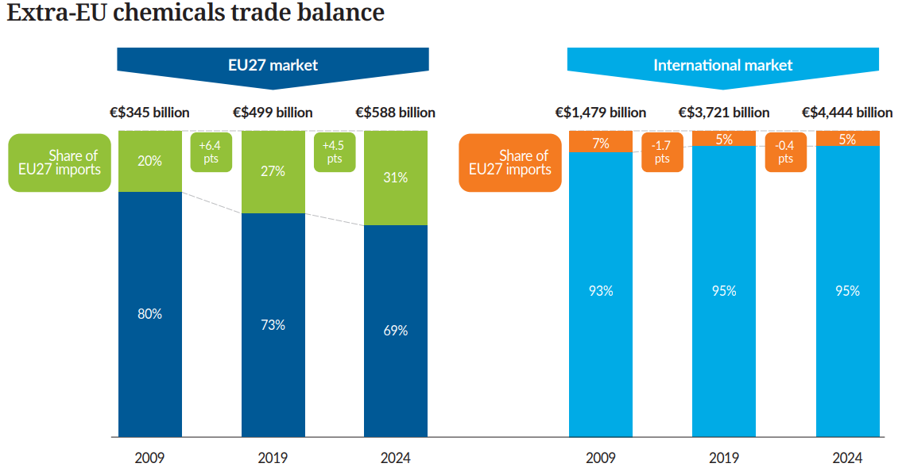
Europe has lost ground both domestically and globally
Source: Cefic Chemdata International

Slide 19
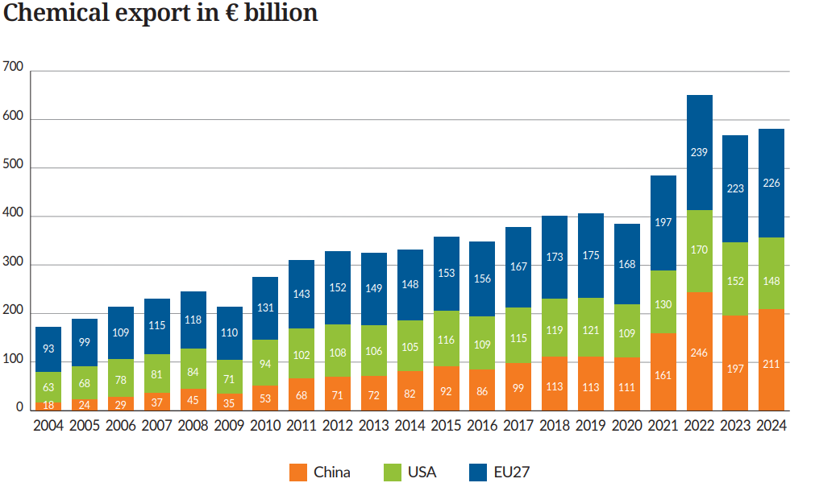
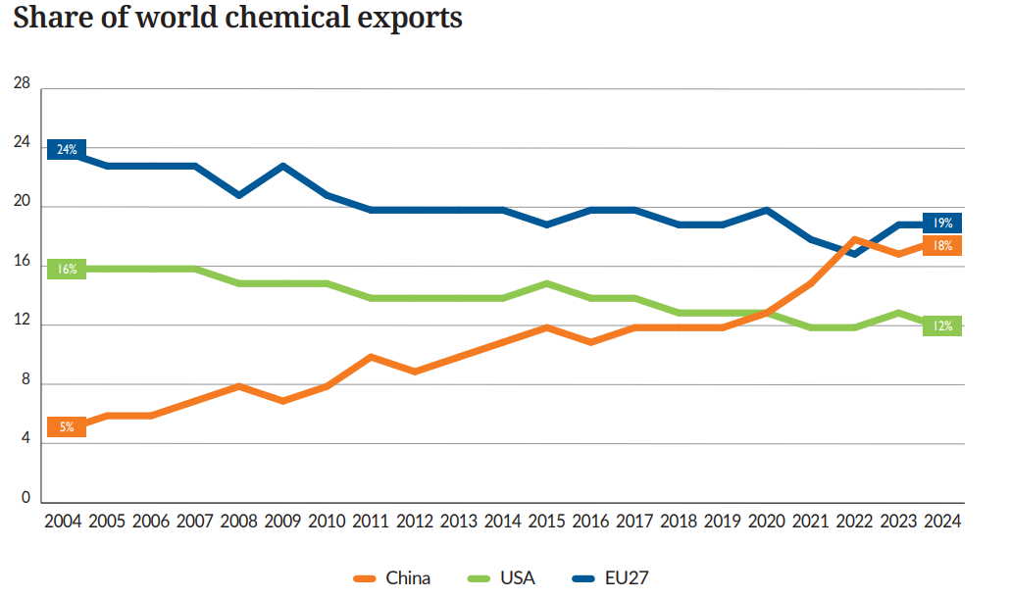
China’s share of global chemical exports continues to rise
Source: Cefic Chemdata International

Slide 20
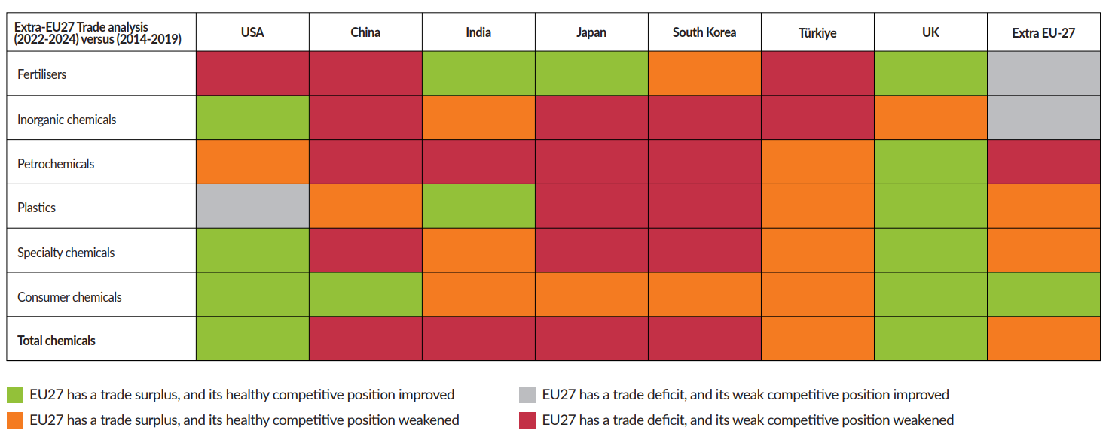
The trade position of upstream sub-sectors shows signs of serious deterioration

Slide 21

3. Growth and Competitiveness

Slide 22
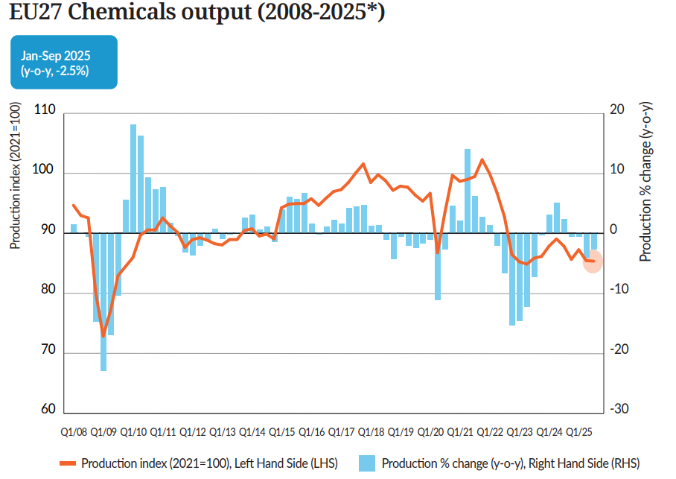
EU27 chemical output remains a key concern
Source: Cefic analysis based on Eurostat data, *2025 (Jan-Sep)

Slide 23
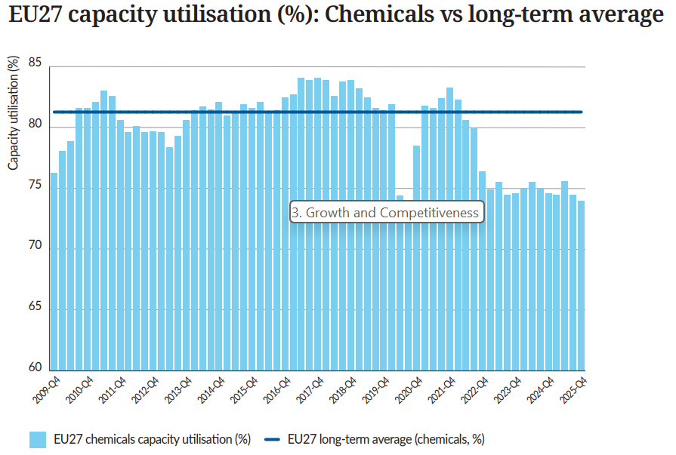
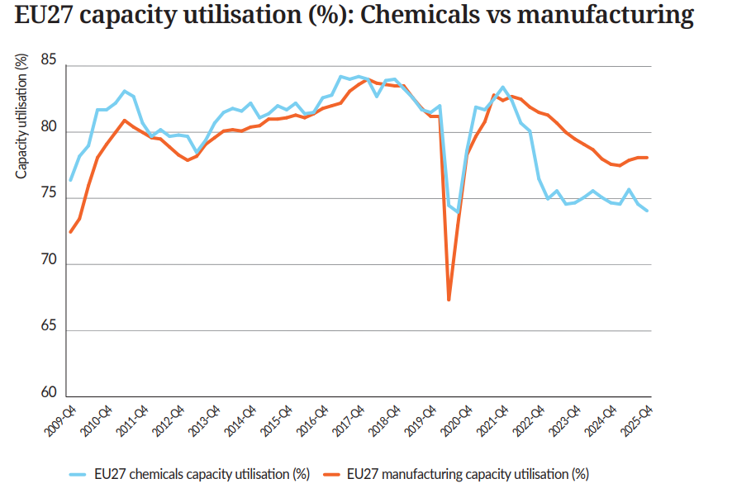
EU27 chemical capacity utilisation remains steadily low (74%)
Source: Cefic analysis based on Eurostat data

Slide 24
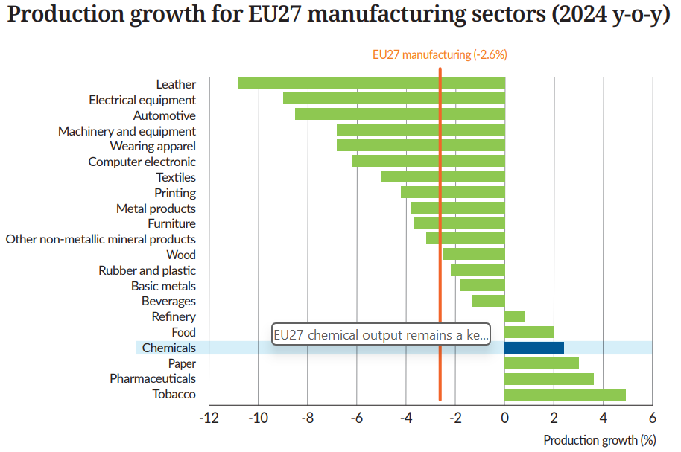
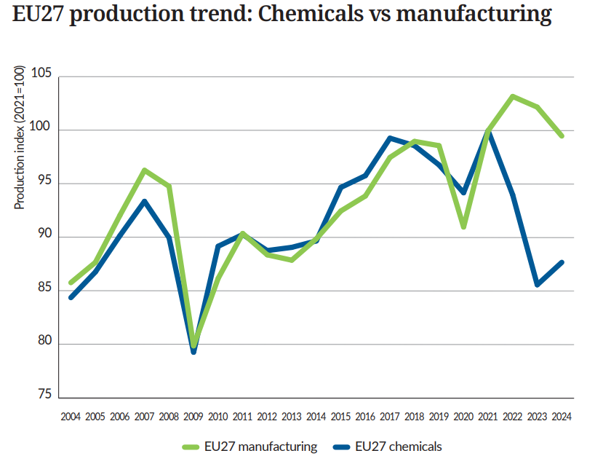
EU27 chemical industry lacks a strong domestic demand
Source: Cefic analysis based on Eurostat data

Slide 25
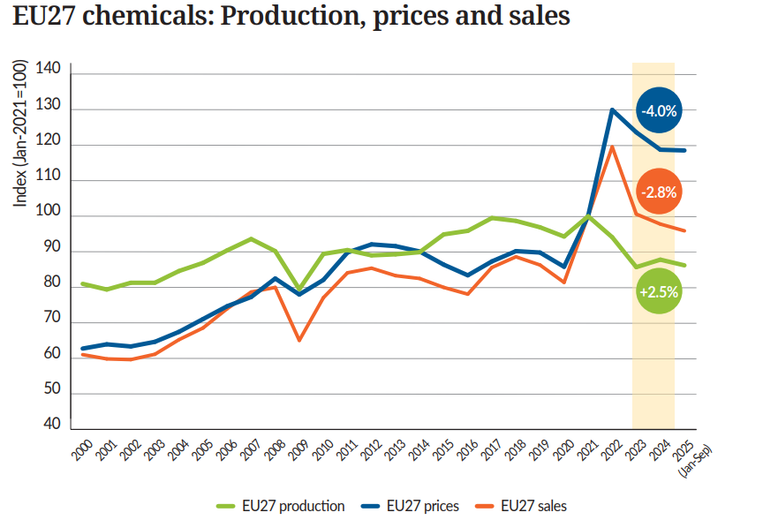
Weak demand continues to weigh on EU27 chemical production
Source: Cefic analysis based on Eurostat data

Slide 26
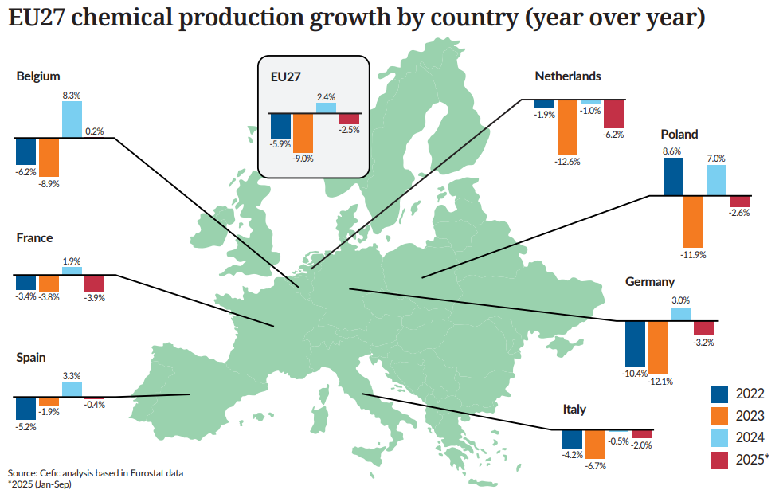
2022-2025*: Different across Europe

Slide 27
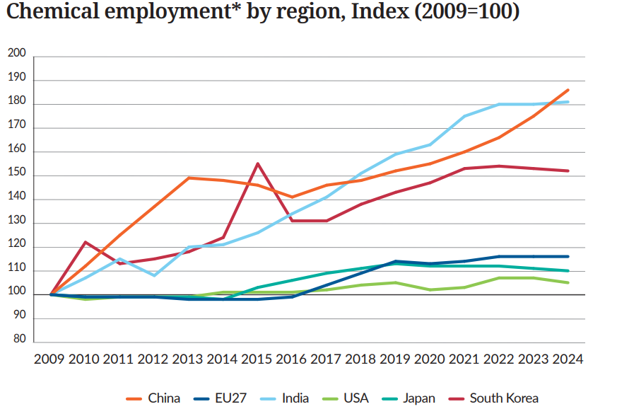
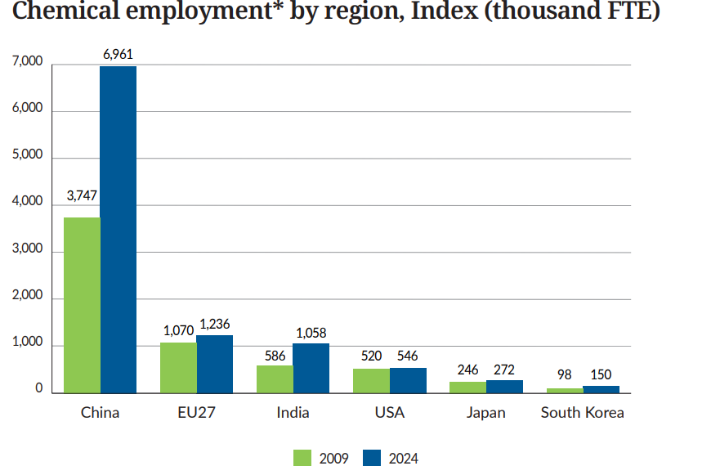
Employment in Europe faces increasing competition from Asia, particularly China and India
Source: Cefic Chemdata International,*Full-Time Equivalent (FTE)

Slide 28
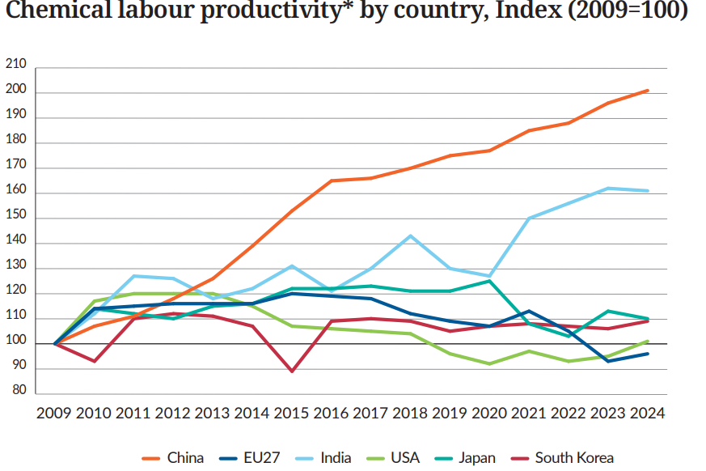
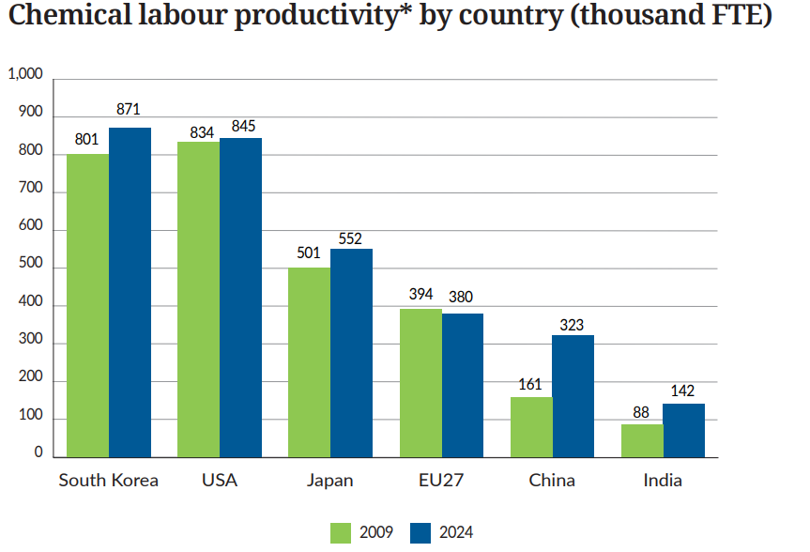
Europe lost labour productivity compared to other regions
Source: Cefic Chemdata International, *Real sales (€k/Full-Time Equivalent, FTE)

Slide 29

4. Our contribution to EU industry

Slide 30
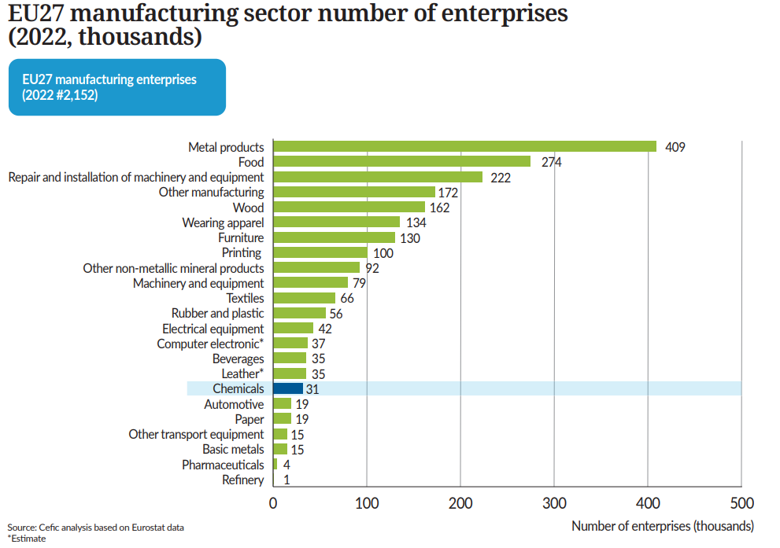
31,000 companies are operating in the EU27 chemical sector
Source: Cefic analysis based on Eurostat data *Estimate

Slide 31
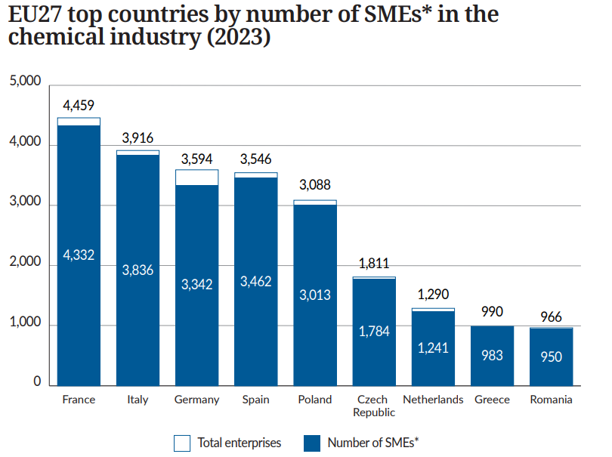
30,264 SMEs* operate in the EU27 chemical industry
Source: Cefic analysis based on Eurostat data, *SMEs: Small and Medium Enterprices

Slide 32
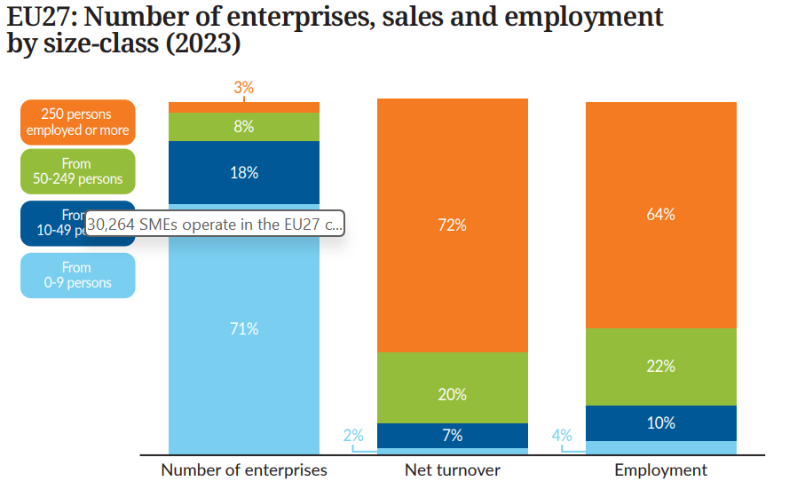
EU27 chemical SMEs* contribute to 28% of sales and 36% of employment
Source: Cefic analysis based on Eurostat data, SMEs: Small and Medium Enterprices

Slide 33
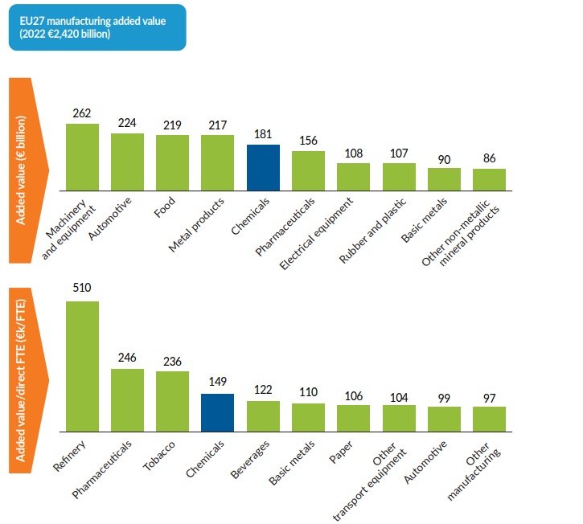
The chemical industry is a major sector in Europe, representing 7% of manufacturing added value
Source: Cefic analysis based on Eurostat data

Slide 34
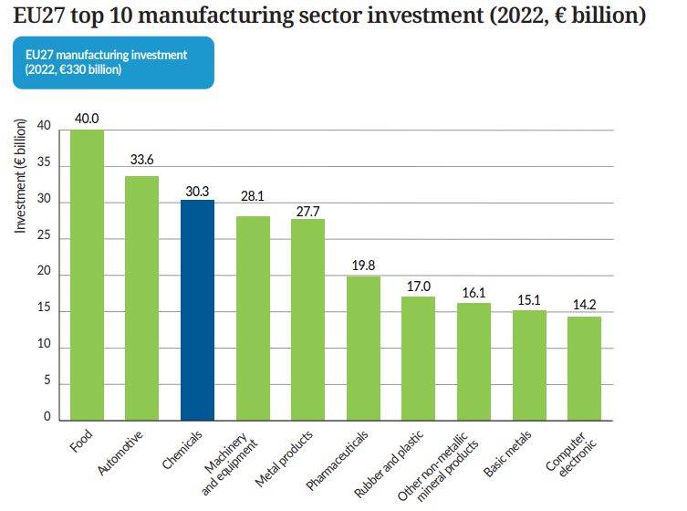
Chemical sector is the third manufacturing sector by investment
Source: Cefic analysis based on Eurostat data

Slide 35
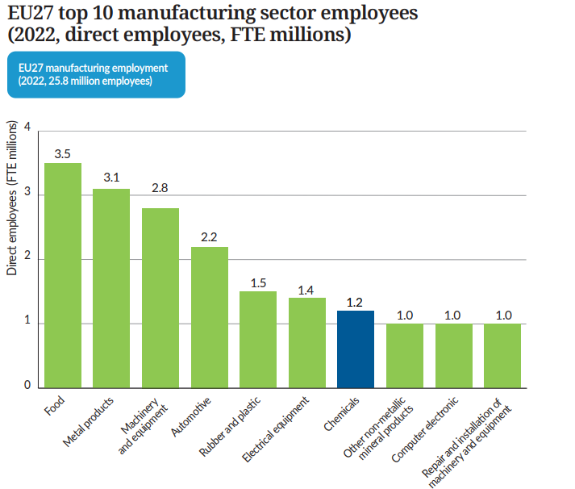
Chemical sector ranks seventh for employment among EU27 manufacturing sectors
Source: Cefic analysis based on Eurostat data, FTE (Full-Time Equivalent)

Slide 36
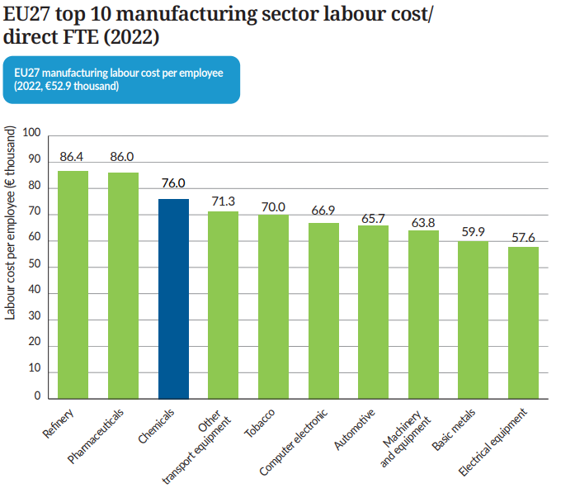
Chemical sector ranks third for labour costs
Source: Cefic analysis based on Eurostat data, FTE (Full-Time Equivalent)

Slide 37
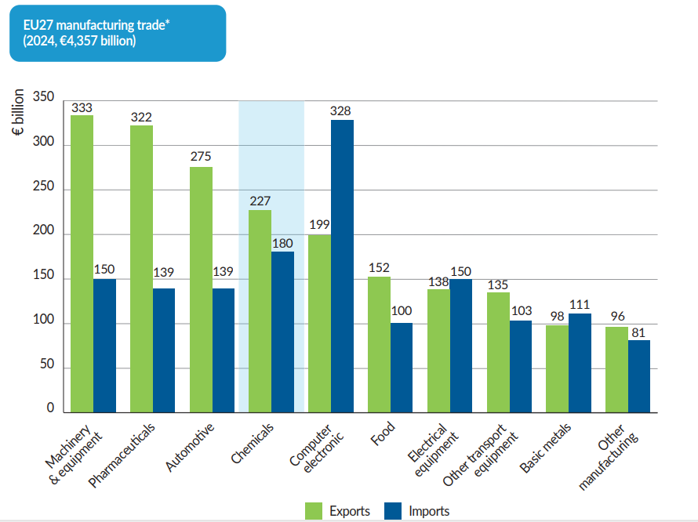
Chemicals are a key contributor to EU27's trade (€407 bn)
Source: Cefic analysis based on Eurostat data, trade = exports + imports

Slide 38

5. Energy Consumption

Slide 39
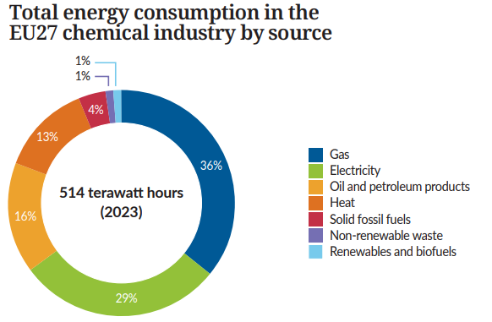
EU27 gas and electricity account for two thirds of total energy consumption of the sector
Source: Cefic analysis based on Eurostat data

Slide 40
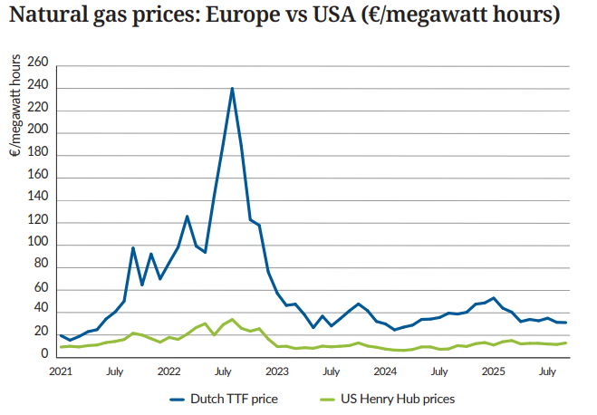
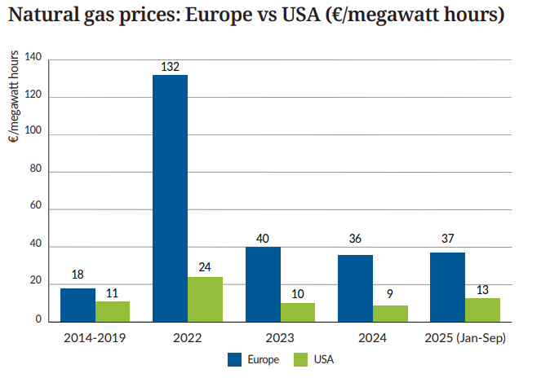
Gas prices remain above the pre-crisis levels
Source ICE Dutch TTF Natural Gas Futures Historical Prices - Investing.com and INSEE Oil Prices data and ICIS

Slide 41
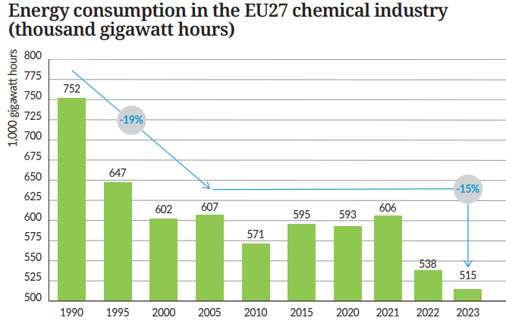
EU27 energy consumption fell by 32% since 1990
Source: Cefic analysis based on Eurostat data

Slide 42
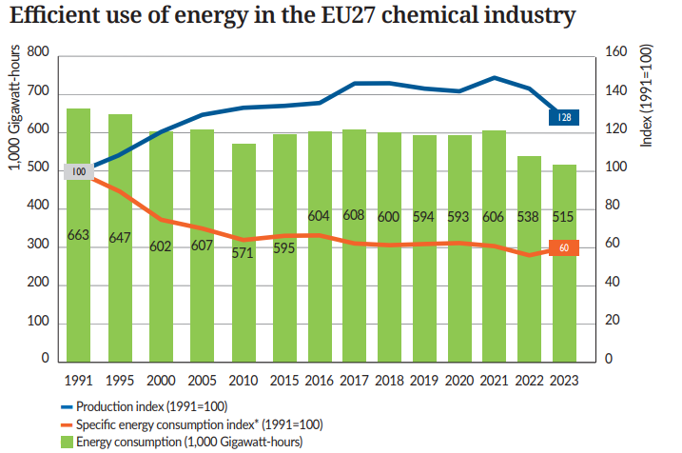
EU27 specific energy consumption* dropped by 40% since 1991
Source: Cefic analysis based on Eurostat data,*Specific energy consumption index is calculated as (energy consumption index/production index), (1991=100)

Slide 43
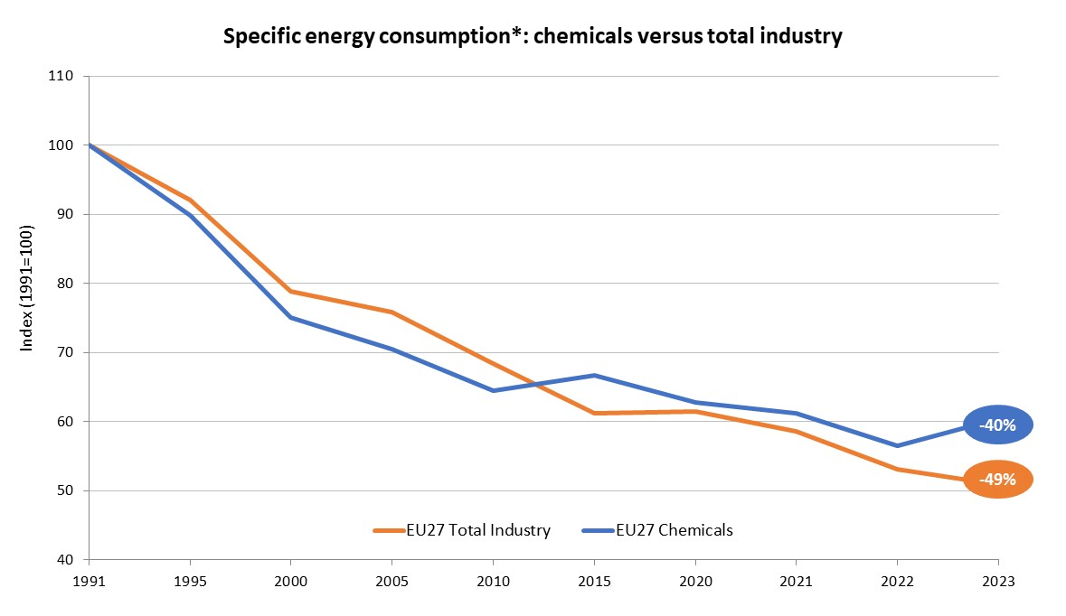
EU27 chemical specific energy consumption* is higher than overall industry
Source: Cefic analysis based on Eurostat data,*Specific energy consumption index is calculated as (energy consumption index/production index), (1991=100)

Slide 44

6. Capital and R&I Spending

Slide 45
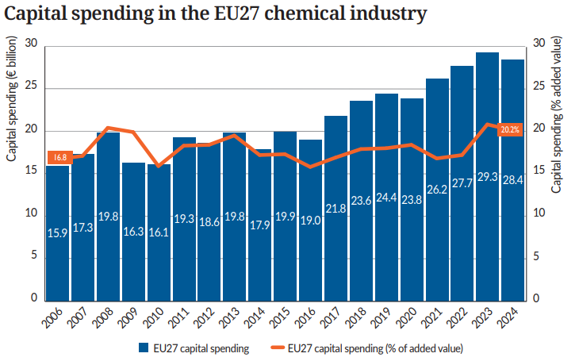
EU27 capital spending decreased in 2024 vs 2023
Source: Cefic Chemdata International

Slide 46
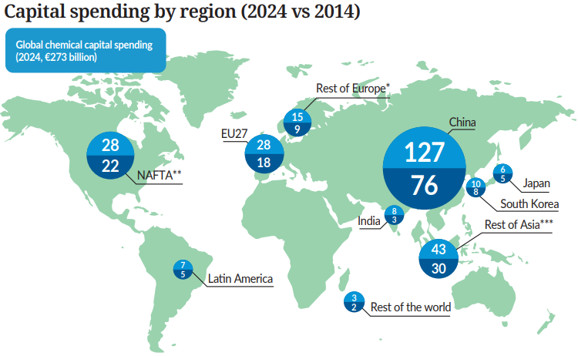
China leads global chemical investment
Source: Cefic Chemdata International
* Rest of Europe covers UK, Switzerland, Norway, Türkiye, Russia and Ukraine
** North American Free Trade Agreement
*** Asia excluding China, India, Japan and South Korea

Slide 47
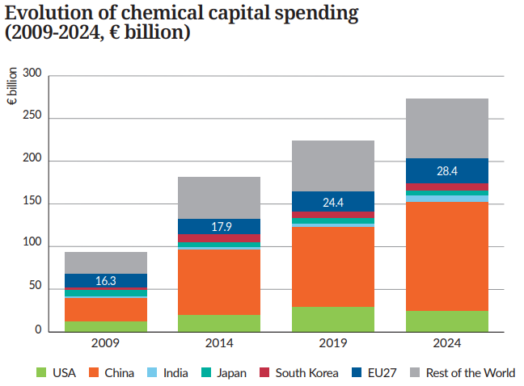
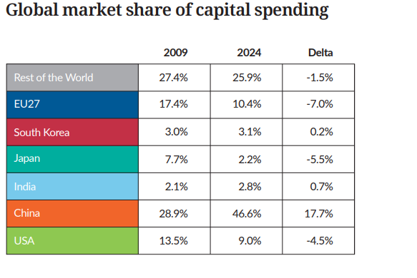
EU27 market share of capital spending dropped significantly
Source: Cefic Chemdata International

Slide 48
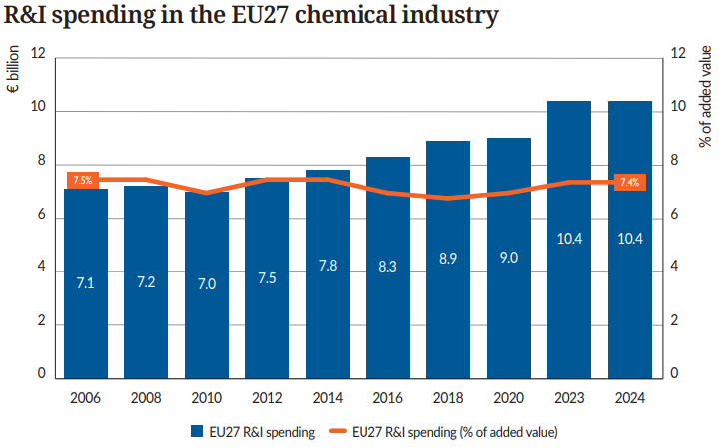
EU27 R&I spending reaches the highest level in 2023 and 2024
Source: Cefic Chemdata International

Slide 49
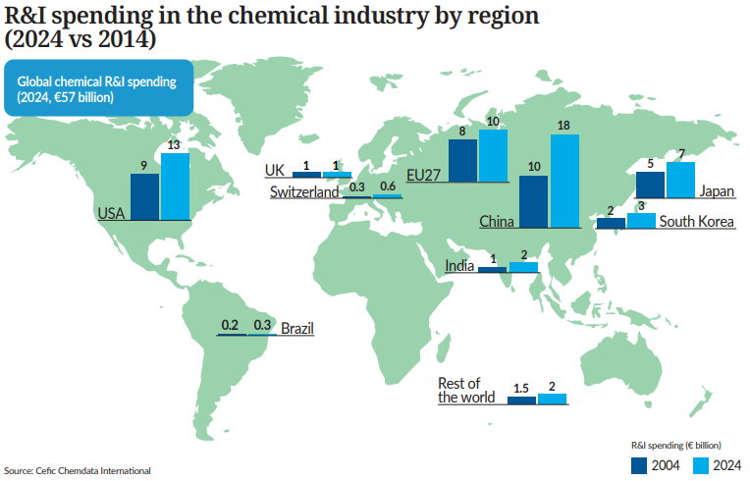
EU27 ranks as the world’s third-largest R&I investor in 2024

Slide 50


EU27 market share of R&D spending has lost ground since 2009
Source: Cefic Chemdata International

